Slide 1
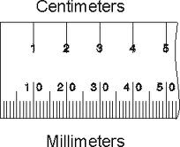
10 mm
1 cm
is the same as...

Slide 2
20 mm
2 cm
is the same as...

Slide 3
3 cm
30 mm
is the same as...

Slide 4
5 cm
50 mm
is the same as...

Slide 5
15 mm
1½ cm
is the same as...

Slide 6
25 mm
2½ cm
is the same as...

Slide 7
3.5 cm
35 mm
is the same as...
½
=
0.5
=
½
=
0.5
=
½
=
0.5
=
½

Slide 8
100 mm
10 cm
is the same as...

Slide 9
15 cm
150 mm
is the same as...

Slide 10
250 mm
25 cm
is the same as...

Slide 11
600 mm
60 cm
is the same as...

Slide 12
66 cm
660 mm
is the same as...

Slide 13
790 mm
79 cm
is the same as...

Slide 14
950 mm
95 cm
is the same as...

Slide 15
99 cm
990 mm
is the same as...

Slide 16
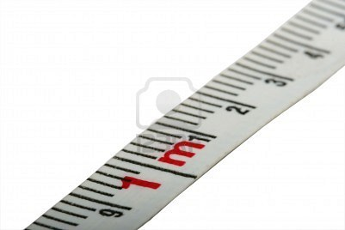
100 cm
1000 mm
is the same as...
is the same as...
1 m

