Slide 1
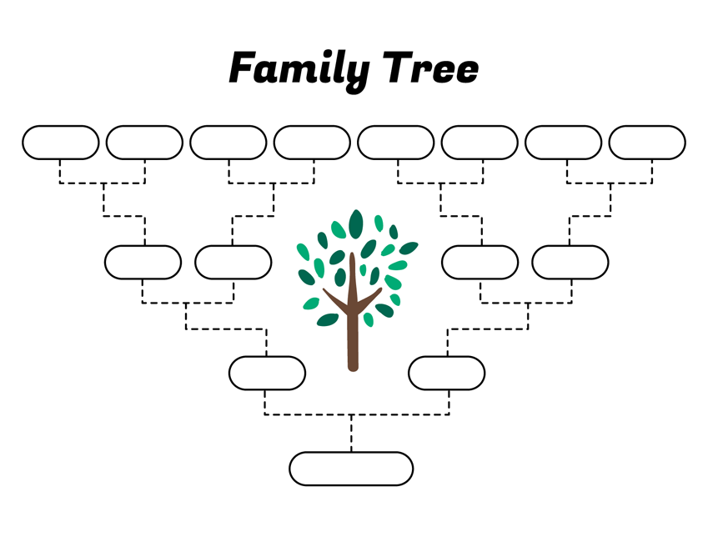
Great- Grandma
Great- Grandad
Great- Granny
Great- Grandad
Great- Grandma
Great- Grandad
Great- Grandma
Great- Grandad
Gran
Grandad
Grandma
Grandad
Mum
Dad
Me
Create a family tree.

