Slide 1
What do you know about the NHS?
Quiz time

Slide 2
1. Who employs the most people in the UK?
1. McDonalds | 2. National Health Service (NHS)
3. Tesco | 4. Google

Slide 3
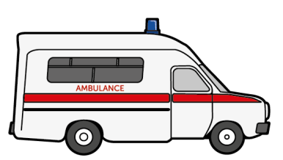
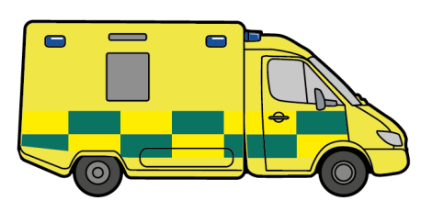
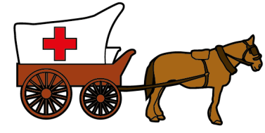
The NHS employs the most people in the UK and is the largest employer in Europe.

Slide 4
2. How many children from our school are likely to work for the NHS in the future?
1. One person from our school will work there | 2. One person from each key stage will work there
3. One person in every year group will work there | 4. One person in nearly every class will work there

Slide 5
1.7 million people work for the NHS in the UK which means someone in every class is likely to work for the NHS in the future.

Slide 6
3. If there were 100 NHS workers in a room, how many do you think would be doctors, nurses and midwives?
1. All of them | 2. More than half
3. Half of them | 4. Less than half

Slide 7
Less than half. It’s not just doctors, nurses and midwives in the NHS. A lot of jobs have nothing to do with blood whatsoever!

Slide 8
4. How many different types of jobs or roles are there in the NHS?
1. Over 350 different jobs | 2. Around 250 different jobs
3. Almost 100 different jobs | 4. Under 50 different jobs

Slide 9
There are over 350 jobs to explore in the NHS.

Slide 10
5. You need to be top of the class in science and go to university to work for the NHS.
True | False

Slide 11
False. There are lots of jobs in the NHS that are not science-based. You don’t need to go to university for them all either. You can enter different jobs in a variety of ways.

Slide 12
6. Which of these jobs can you do for the NHS?
Gardener | 2. Driver
3. Surgeon | 4. Chef

Slide 13
You can do all of these jobs and so many more for the NHS.

Slide 14
7. Can men be midwives and nurses? True or false
True | False

Slide 15
Yes. Men and women can both be midwives so long as they have all the same training and skills.

Slide 16
8. Which of these jobs can be only be done by a man or a woman?
Surgeon | 2. Children’s nurse
3. Paramedic | 4. Doctor

Slide 17
They can all be done by men or women. Different people will prefer to do different jobs. One might love caring for children and become a nurse for the NHS. Another might choose to train as a surgeon.

Slide 18
9. Everyone has the same opportunities to do a job as each other? True or false
True | False

Slide 19
True. Everyone has the same rights to opportunities as each other.

Slide 20
10. The NHS has been helping us for many years, but in which year was it born?
a) 1978 | b) 1918
c) 1998 | d) 1948

Slide 21
d) The NHS was launched in 1948 It was set up to provide free healthcare to everyone and employed 144,000 people in 1948.

Slide 22
What did you learn?
Now take a look at the different jobs you could do in the
Job Cards Document.

