Slide 1
Create your Competition entry

Slide 2
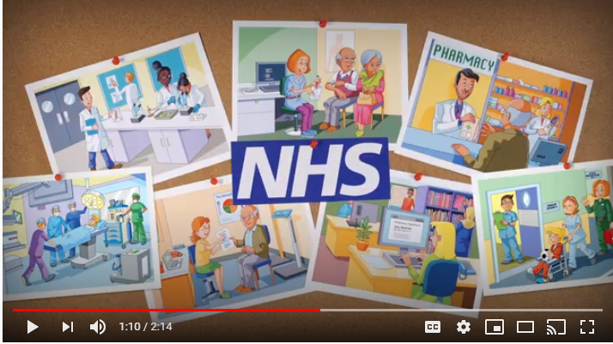
Watch the video about the NHS and our exciting competition @
The date shown on the video is wrong!
Closing now 19th June 2020.
https://www.youtube.com/watch?v=hQjqqQ-lGMY&feature=youtu.be

Slide 3
A recap of the key points…

Slide 4
Say thank you to the NHS by taking part in our competition Get creative... Produce a piece of artwork or performance art, for example: a painting, drawing, video, collage or temporary street art OR a poem, story, song or dance

Slide 5
The prizes
There are some fantastic prizes available for winning students*:
Overall national winner(s) will receive Amazon vouchers worth £50
Ten regional winners will each receive an Amazon voucher worth £25
Highly commended certificates will also be awarded
April 2020 update: The specifics of the national winner’s prize beyond vouchers will be discussed with the winning school, to ensure something appropriate can be awarded should the previously listed class trip to a local science venue not be appropriate at this time.
*Whether you enter individually or as a pair, each of you will receive a prize if your entry is chosen.

Slide 6
How will you say thank you to the NHS?
Think about the wide range of jobs you have learnt about and how the NHS helps people. You can say thank you to people who do a particular job you have seen or say thank you to a whole team!
You have the chance to win fantastic prizes!

Slide 7
Some simple rules
You can work on your own or in pairs | Online entries accepted only (individual files should not exceed 50MB) | The closing date for entries is 19 June 2020
I will send you my e mail address via class dojo. Can you then send me your entries by 15th June to give me time to upload them!

