Slide 1
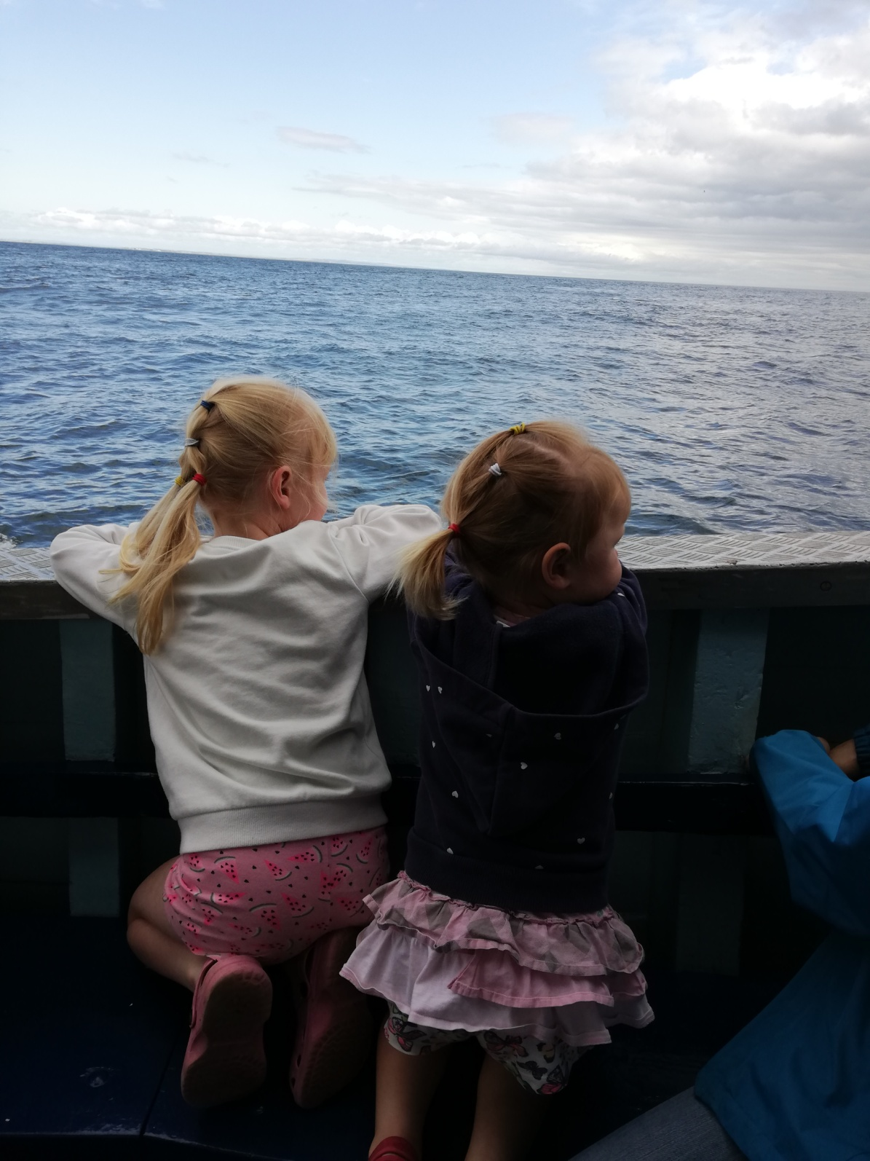
Our boat trip to the Farne Islands.

Slide 2
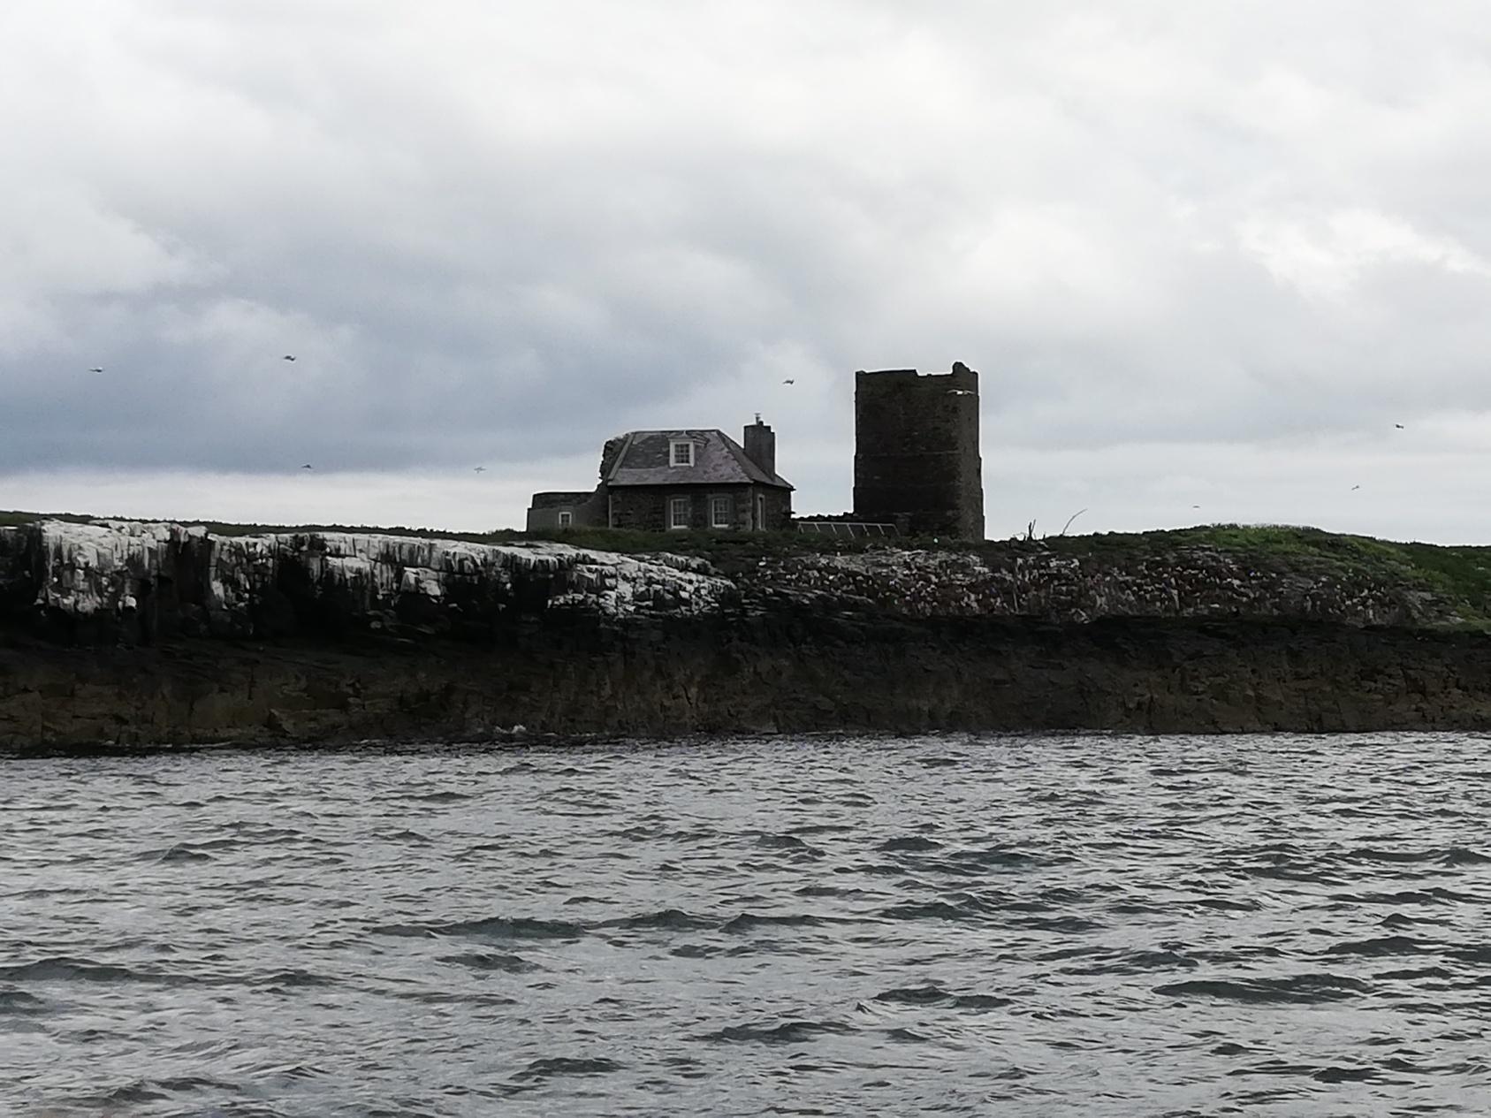
The oldest lighthouse where Grace Darling first lived. Brownsman lighthouse.

Slide 3
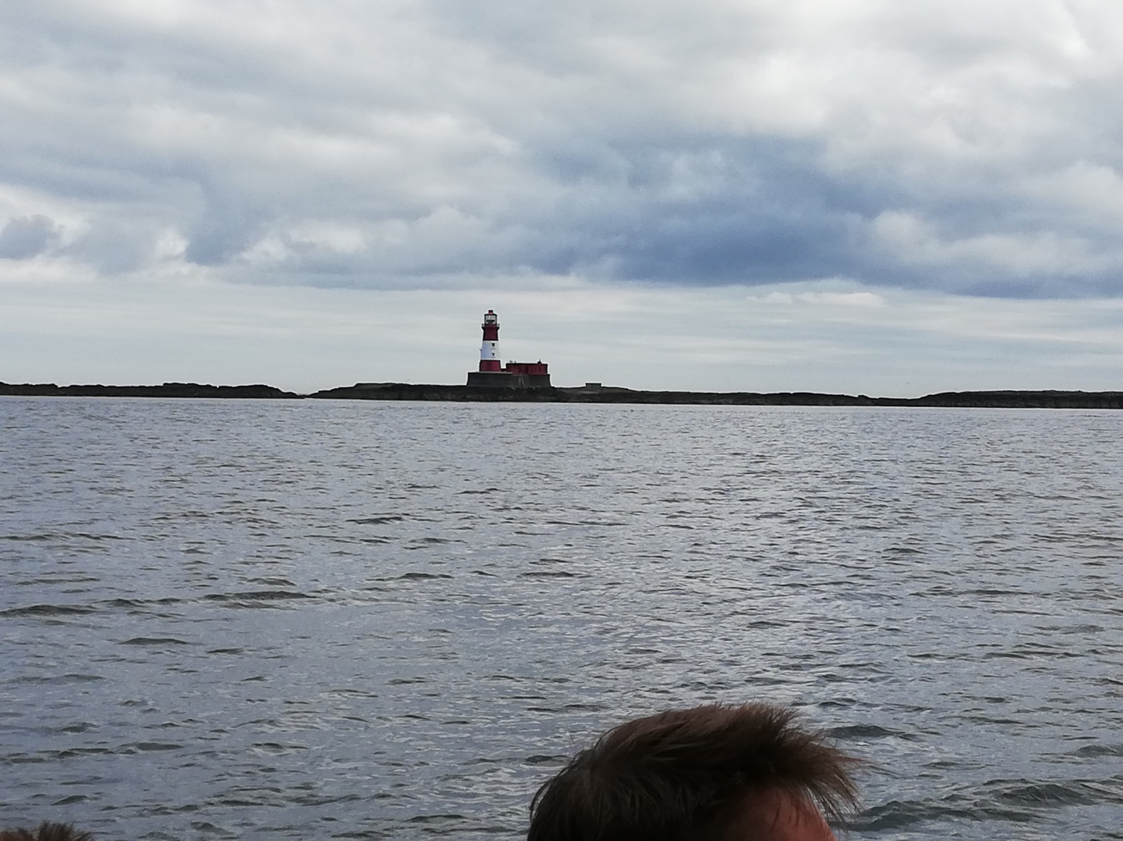
Longstone lighthouse where Grace Darling moved to with her family and where the rescue took place. 7 miles from shore.

Slide 4
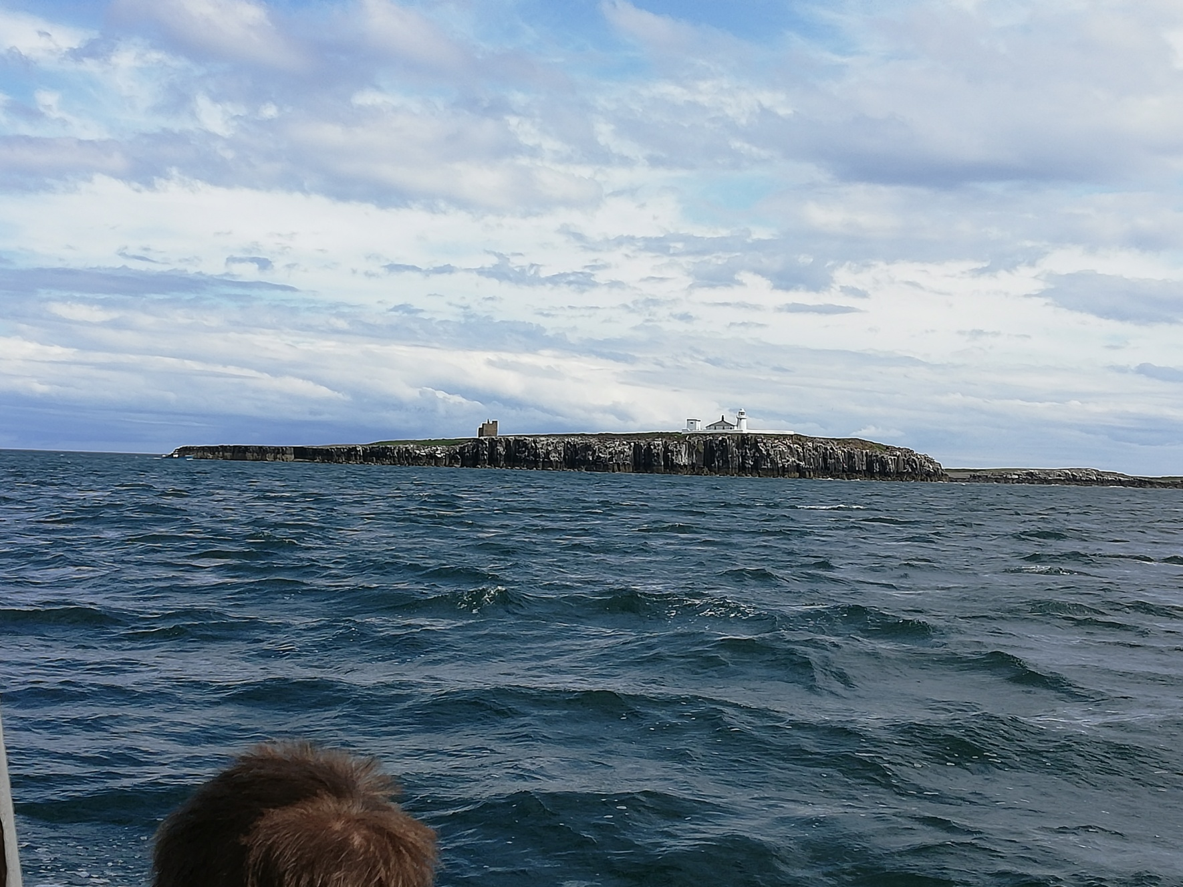
The new lighthouse is still in use today.

Slide 5
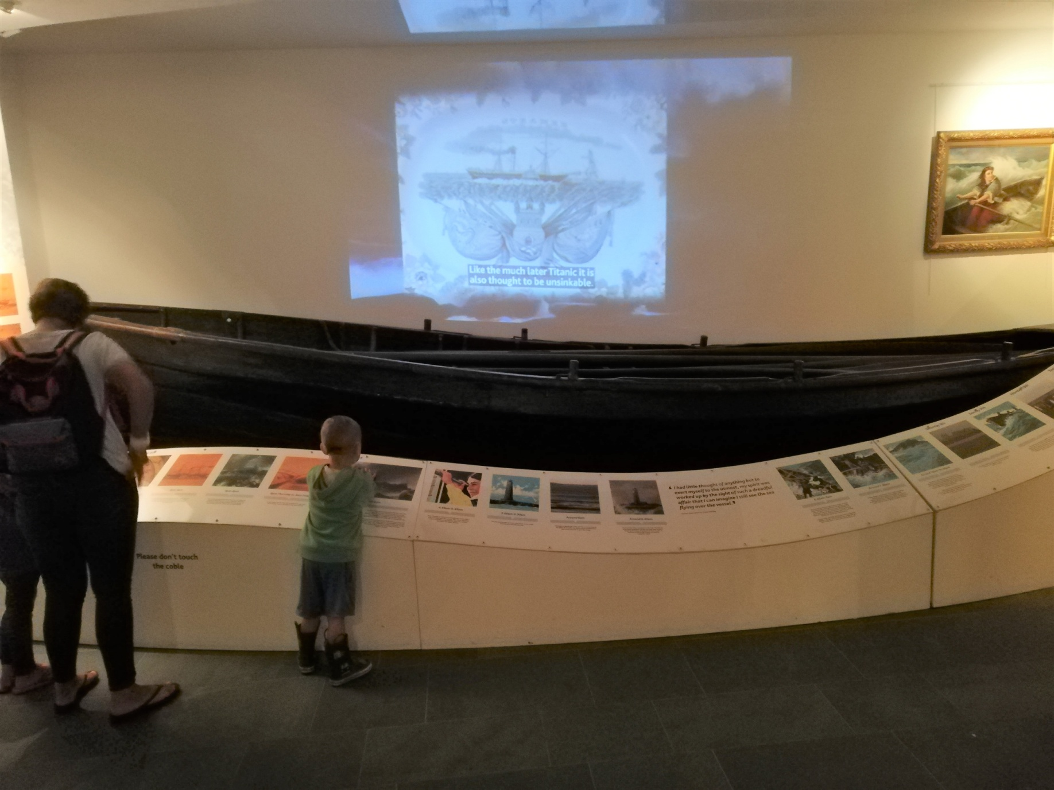
Grace Darling’s boat. Inside the Grace Darling Museum in the village of Bamburgh.

Slide 6
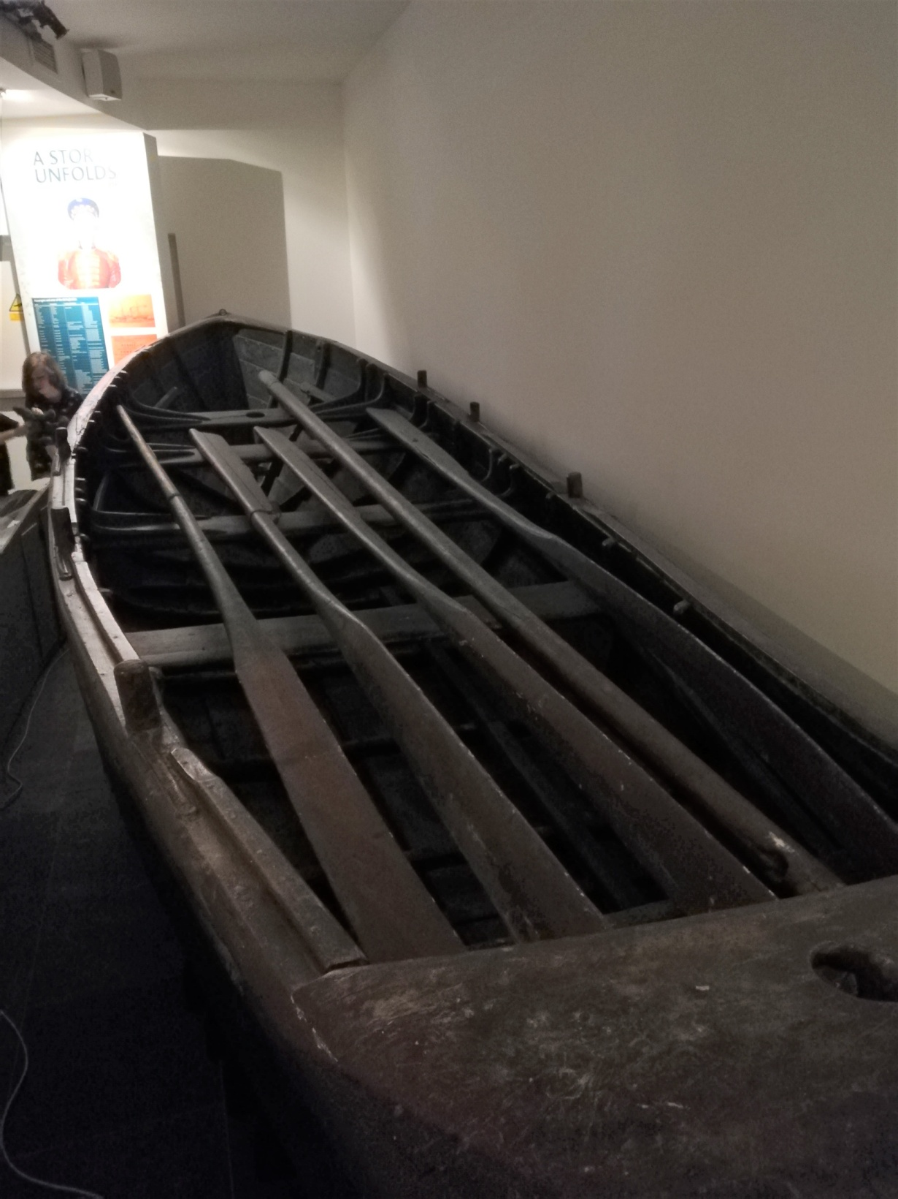

Slide 7
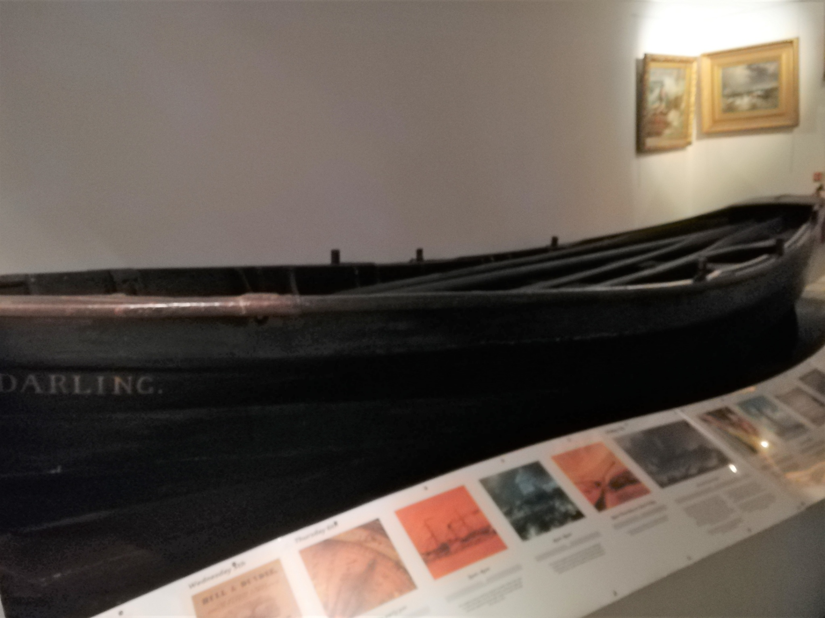

Slide 8
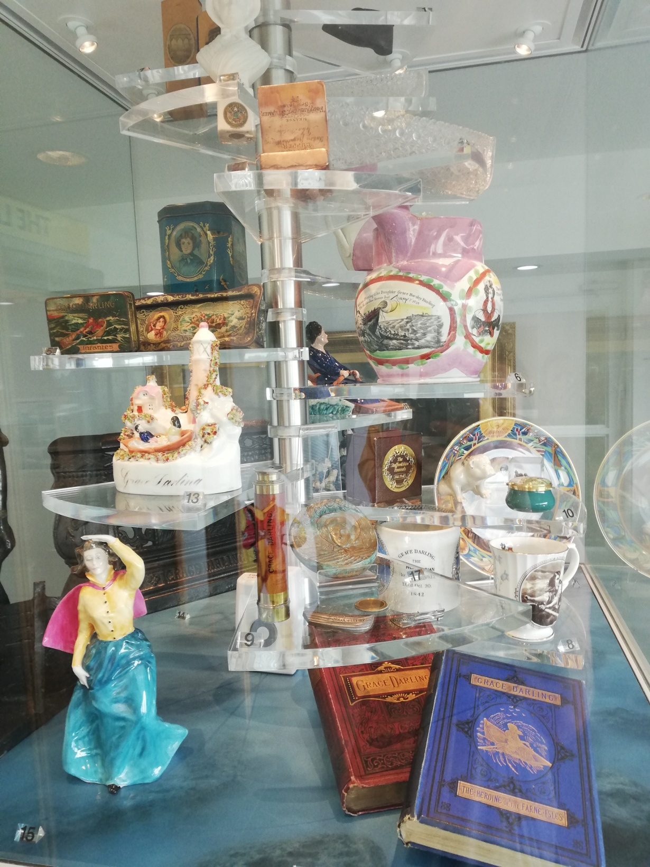
Grace Darling souvenirs of the time.

Slide 9
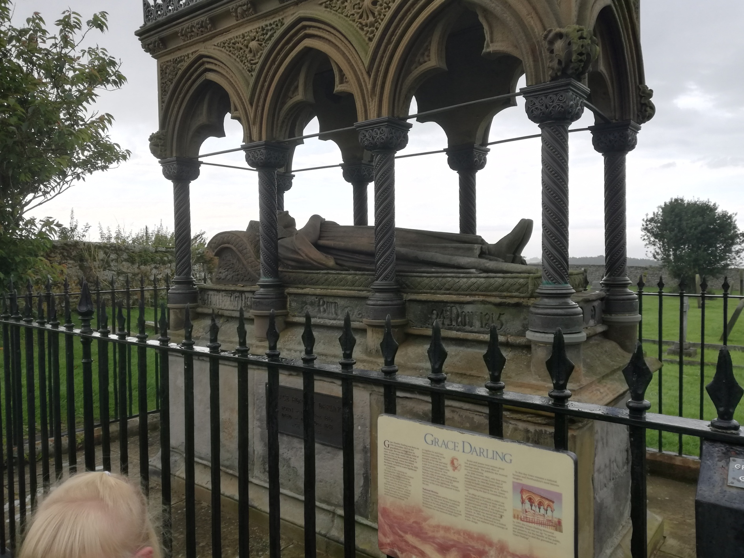
Grace Darling’s Tomb in the church yard of St. Aidens Church in Bamburgh.

Slide 10
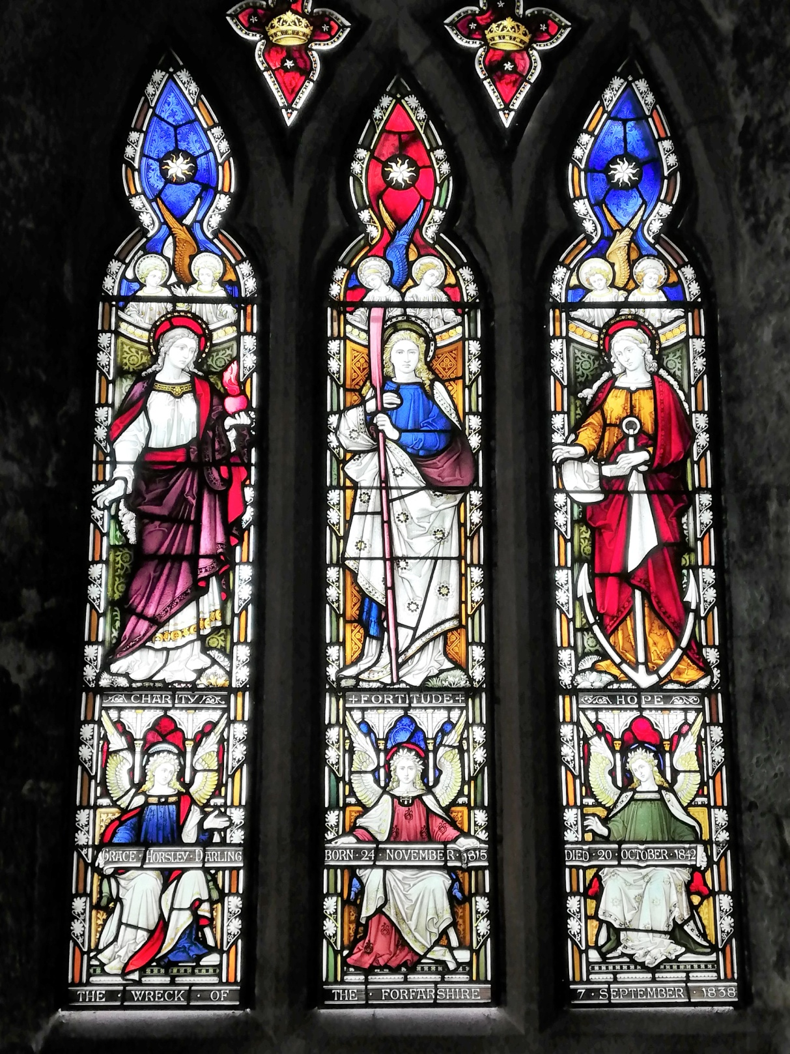
Grace Darling remembered in St Aiden’s Church of Bamburgh in the stained glass windows.

