Slide 1
Oceans for beginners
X-Curric | Ages 7-11
Lesson 1
Our wonderful ocean

Slide 2
Lesson 1: Our wonderful ocean
Name a variety of ocean habitats and species that live there
Understand the scale and depth of the ocean
Conduct research about an iconic marine species
Record and present findings
Ask questions and reflect on learning

Slide 3
Lesson 1: Our wonderful ocean
What do you know about the ocean?

Slide 4
Lesson 1: Our wonderful ocean
You have 30 seconds to name all the marine animals you can think of.
Keep a tally.
Try not to repeat any!

Slide 5
Lesson 1: Our wonderful ocean
The Blue Planet
How much of the Earth do you think is covered in water?

Slide 6
Lesson 1: Our wonderful ocean
The Blue Planet
71% of our planet is covered in water.
The ocean produces half the oxygen we breath.
It captures 16 times the carbon compared with land.

Slide 7
Lesson 1: Our wonderful ocean
Ocean icon
Tiger shark
One of the largest sharks in the world, the tiger shark is one of the top predators in the ocean. It gets its name from the dark stripes along its sides that resemble a tiger's stripes. It is a solitary creature, mainly hunting at night.

Slide 8
Lesson 1: Our wonderful ocean
Ocean icon
Green turtle
Green turtles are one of the six species of sea turtle that are found on the Great Barrier Reef.
Green turtles lay their eggs in pits they dig on beaches on islands and cays. Female turtles return to the beaches where they hatched to lay their eggs.

Slide 9
Lesson 1: Our wonderful ocean
Ocean icon
Bottlenose dolphin
Bottlenose dolphins live all over the world. They are excellent swimmers, because of their arrow-like shape. Bottlenose dolphins are some of the cleverest animals on Earth because of their large brain.
Bottlenose dolphins cannot breathe underwater and have to rise to the surface to breathe oxygen from the air.

Slide 10
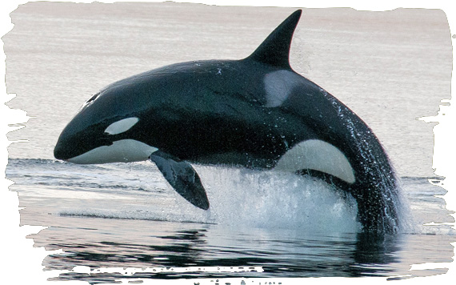
Lesson 1: Our wonderful ocean
Ocean icon
Orca
Streamlined and powerful, the orca is one of the ocean’s fastest mammals, reaching up to 56 km/hour. Orca are also intelligent, good communicators and extremely social; with some choosing to stay with their maternal pod for life. Found from Pole to Equator, pods can cover up to 100 miles a day searching for food.

Slide 11
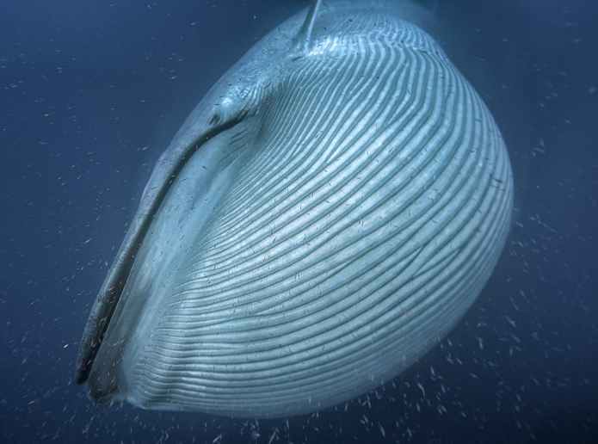
Lesson 1: Our wonderful ocean
Ocean icon
Blue Whale
The blue whale is the largest living animal known to have ever existed on Earth. It can grow up to 100 feet and weigh up to 200 tons. This mammal lives in the ocean and feeds on krill.

