Slide 1
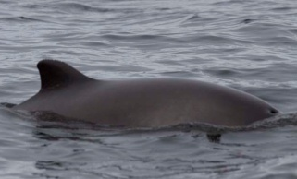
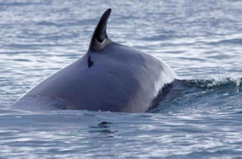
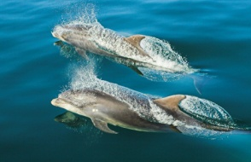
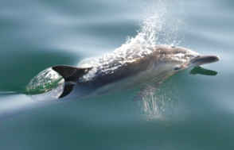
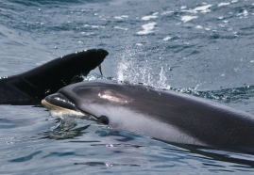
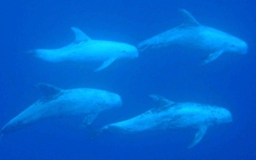
Whales and Dolphins in Captivity

Slide 2
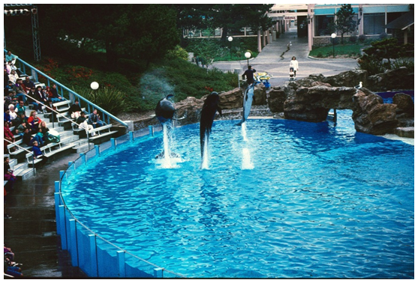
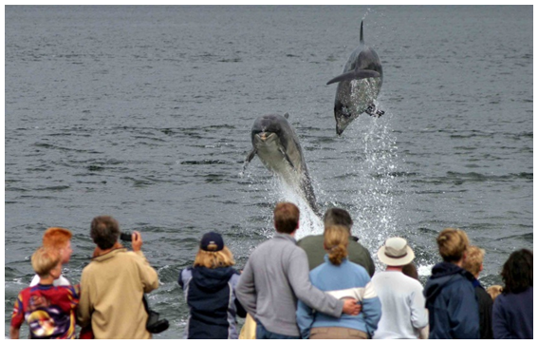
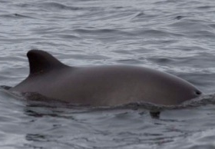
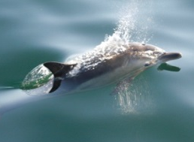
Whales and Dolphins in Captivity
WDC wants to see an END to the keeping of cetaceans in captivity
WHY?
Notes:
Explain WDCS’s stance on captivity – no cetacean should be kept in captivity.
WDCS campaigns against the capture, trade and confinement of cetaceans (whales, dolphins and porpoises) because we believe it is inherently cruel to restrict such social, intelligent and wide-ranging animals in captivity, where their physical, social and mental needs cannot be met. Captivity threatens the welfare and conservation of cetaceans.

Slide 3
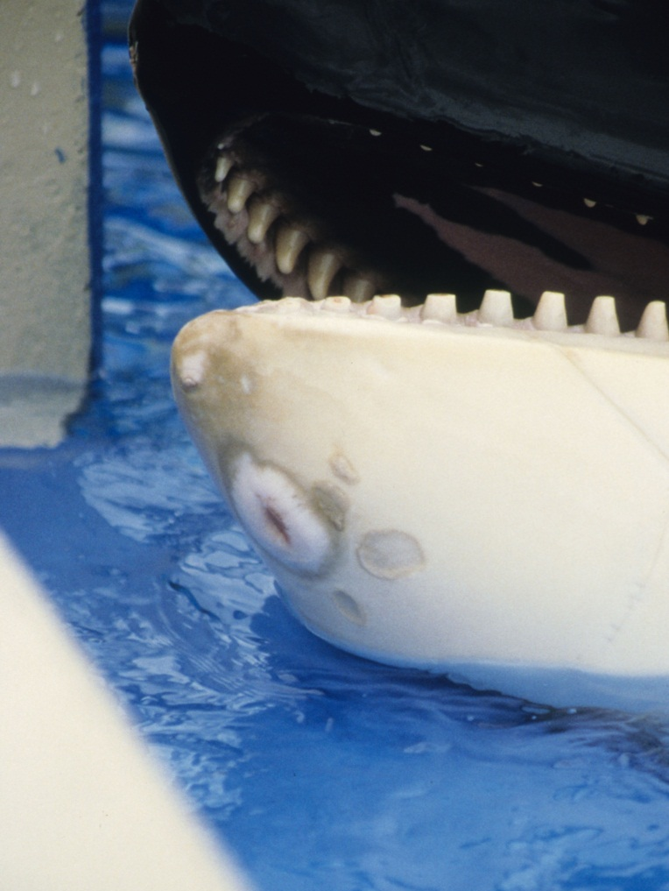
Whales and Dolphins in Captivity
Physical Health
Shorter life spans
Chemicals cause skin lesions
Transport is stressful
Babies are often taken away from mothers when they are too young

Slide 4
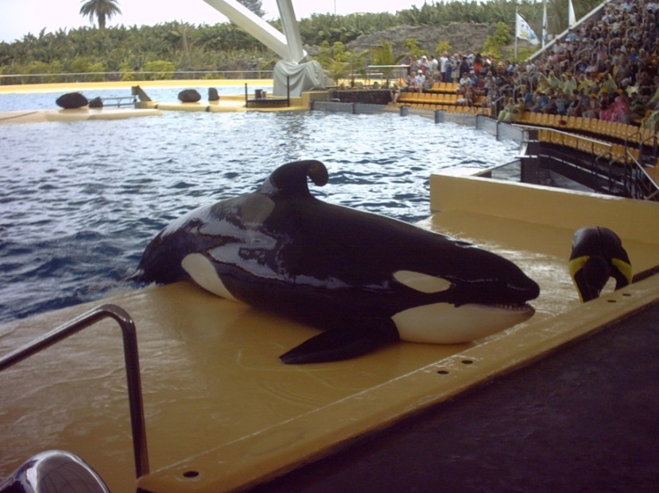
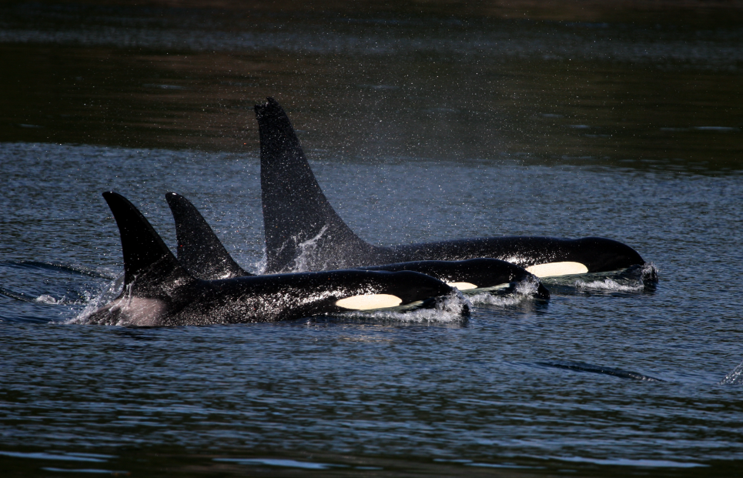
Whales and Dolphins in Captivity
Mental Health
Wild orca spend all their lives in family groups – they are NEVER ALONE
Limp fin is a symptom of captivity
that may be a sign of poor health
or spending too much time at
the surface
Notes:
100% of male orcas in captivity have limp dorsal fins.
Less than 1% or wild orcas do.

Slide 5
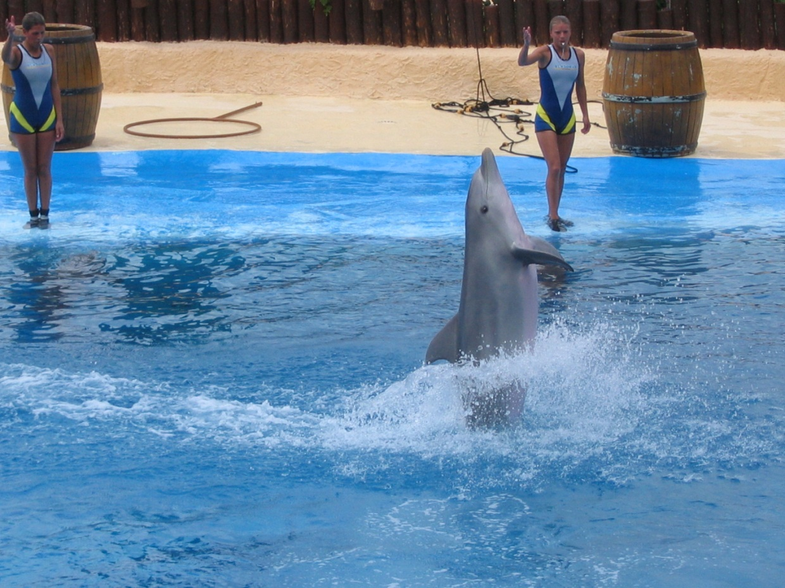
Whales and Dolphins in Captivity
Boredom
Tricks like tail
walking are NOT
NATURAL
BEHAVIOUR
for dolphins – NOT
EDUCATIONAL
Notes:
The primary justification for the public display of marine mammals is the educational benefit of these exhibits. Whale and dolphin displays significantly distort the public’s understanding of the marine environment. Educational messages often take second place to the whale and dolphin performance, which are the main feature of dolphinariums. The tricks that are displayed are exaggerated variations of natural behaviours and do little to further the public’s knowledge of cetaceans and their habitats.
In addition, the complex nature of the lives of whales and dolphins cannot possibly be illustrated with reference to animals in a tank. Educational materials offered by captive facilities often blatantly omit facts about a species’ unique social structure and acoustic repertoire, as well as its remarkable extended families and natural tendency to range freely over vast areas. Visitors to captive facilities may be subject to mis-information, and leave with a distorted perception of cetaceans and their marine environments.

Slide 6
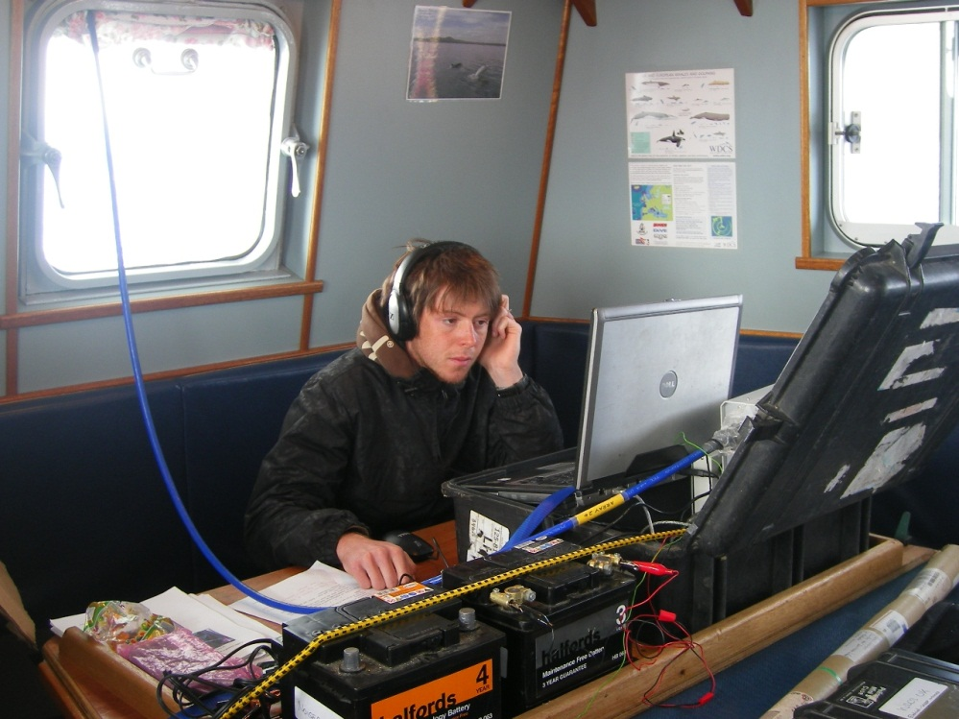
Whales and Dolphins in Captivity
Do dolphinariums help wild dolphins?
Less than 5-10% are
involved in substantial
conservation programmes
Research on captive
cetaceans cannot be
applied usefully to wild
populations
Notes:
Fewer than 5% to 10% of zoos and aquaria are involved in substantial conservation programs. The amount spent on these programmes is a mere fraction of the income generated by the facilities. Simply exhibiting wildlife can not be considered as conservation. Knowledge gained on behaviour and health-related issues in the captive environment cannot be applied usefully to wild cetacean populations. Captive dolphins live in an artificial environment and may be subject to medication that alters their body chemistry. They also follow the same basic routine rather than the varied daily movements of a free-living cetacean. The majority of research conducted on captive animals relates to improving husbandry practices, not to solving conservation problems. Studies of free-living cetaceans are becoming more and more sophisticated, providing increasingly useful data for the conservation of cetaceans in the wild. Whale and dolphin captures still occur routinely around the globe. Captures are very stressful and can result in the deaths of the individuals targeted.

Slide 7
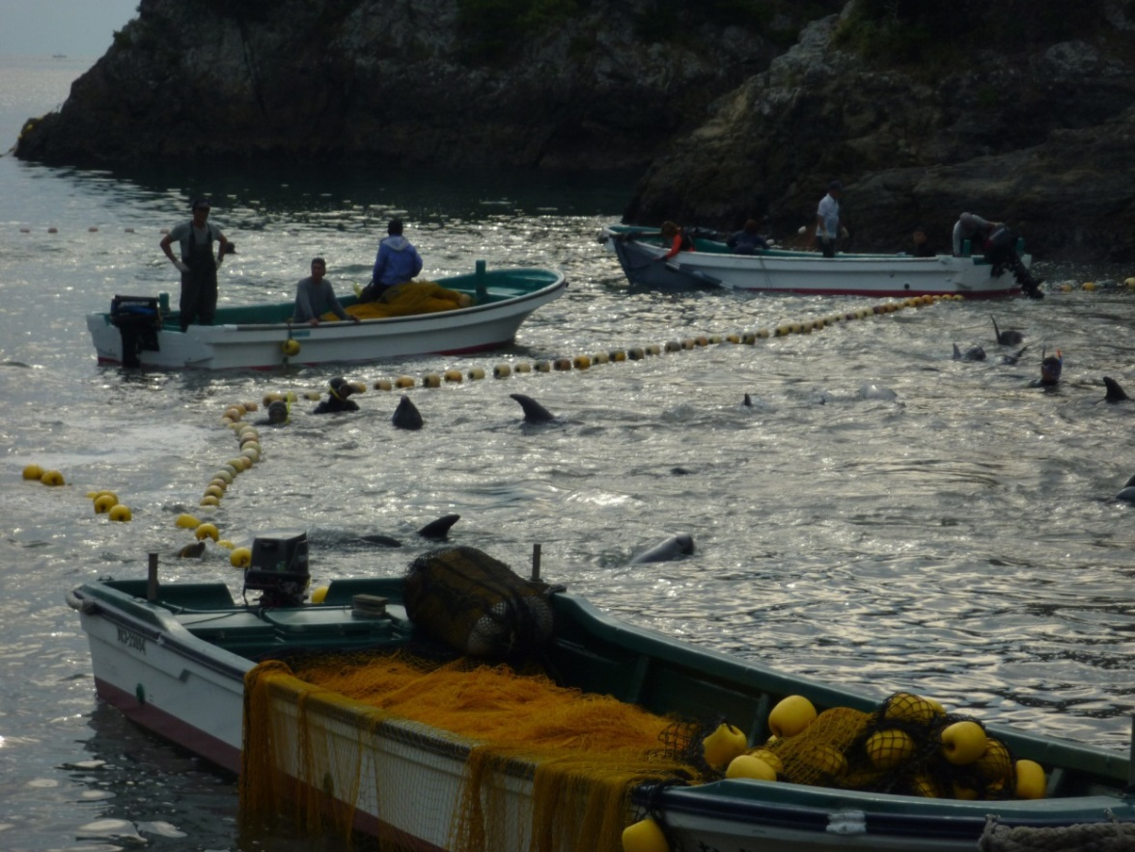
Whales and Dolphins in Captivity
Drive Hunts
In the 2013-2014 season,
at least 834 dolphins were
slaughtered
150 dolphins were taken
alive for captivity
The quota for 2014-15 is
1938 dolphins
Taiji Cove, Japan
Notes:
WDCS document the hunts, organise protests against the Japanese government and raise awareness of the issue.
Japanese Drive Hunts: The annual dolphin drive hunt kills around 2,000 dolphins each year. WDCS has exposed the fact that these hunts are being fuelled by the aquarium industry, which also takes dozens of animals alive from the hunts each year, mainly for Japanese aquariums. Some of these dolphins have now been exported to China, Turkey and Dubai.
This devastatingly cruel practice involves the corralling of dolphins at sea and driving them into the confines of the cove in Taiji. Here they are slaughtered for meat or kept alive for sale to marine parks and aquaria across the globe. Yearly government quotas for these drive hunts reach into the thousands (2014-15 small whale & dolphin quota by all killing methods is 15,773), where small whales and dolphins of several species including bottlenose dolphins, striped dolphins, spotted dolphins, false killer whales and short-finned pilot whales, are targeted and killed, with others taken alive for the captivity industry.

Slide 8
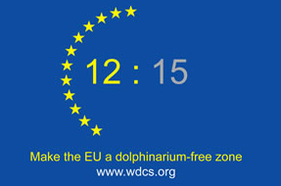
Whales and Dolphins in Captivity
Over 300 whales and
dolphins are held in
captivity in 15 countries
in the EU
This violates EU law
Make the European Union a dolphinarium-free zone
Notes:
Keeping dolphins in captivity violates EU legislation that is supposed to protect these animals
It is supposed to encourage conservation, yet dolphin survival rates are lower in captivity than in the wild
It is supposed to promote education about animals, yet little information is given at dolphin shows in the EU about their lives in the wild
It is supposed to prevent cruelty to animals and look after their welfare, yet stress and disturbing behaviour is common amongst dolphins displayed in dolphinaria within the 15 Member States of the EU who are failing to implement EU legislation properly.
We have no right to keep whales and dolphins in captivity.
We want to make the European Union a dolphinarium-free zone
We are calling for:
The European Council of Ministers and the European Commission to take urgent steps to protect whales and dolphins in captivity in the EU
A ban on the import of wild-caught dolphins into the EU
Member States to enact strict legislation for the keeping of these animals in captivity and enact plans to phase out national dolphinaria and not grant permits for the construction of any new dolphinaria.

Slide 9
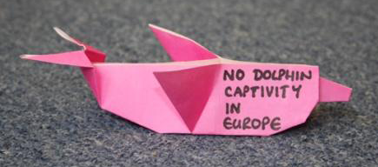
Whales and Dolphins in Captivity
What can you do?
Sign WDC’s petition targeting airlines that transport dolphins caught in drive hunts at www.whales.org
Make an origami dolphin – we have presented 30,000 to the European Parliament and are
now collecting more to
campaign in member states

Slide 10
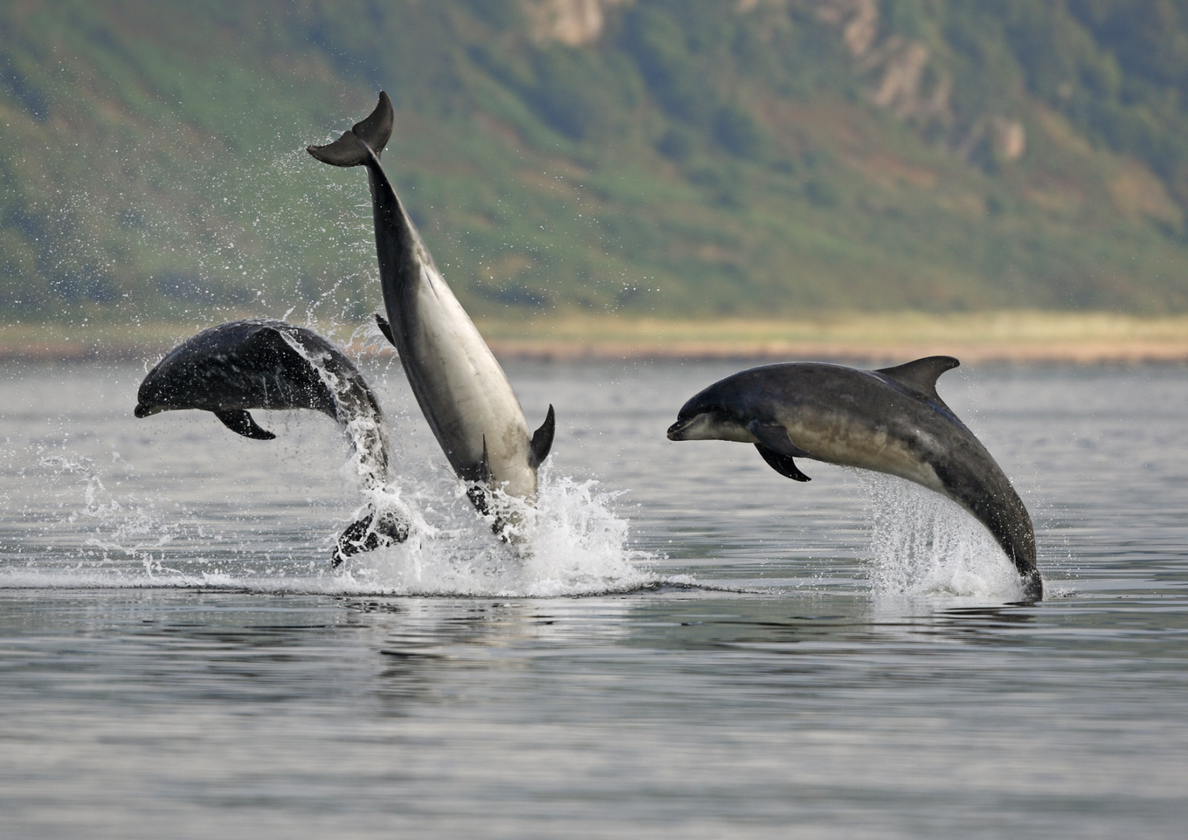
Whales and Dolphins should be FREE

