Slide 1
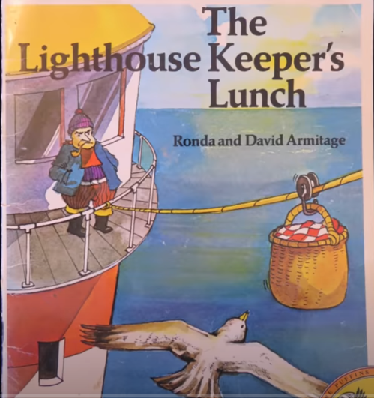
The lighthouse keeper’s Lunch - Settings

Slide 2
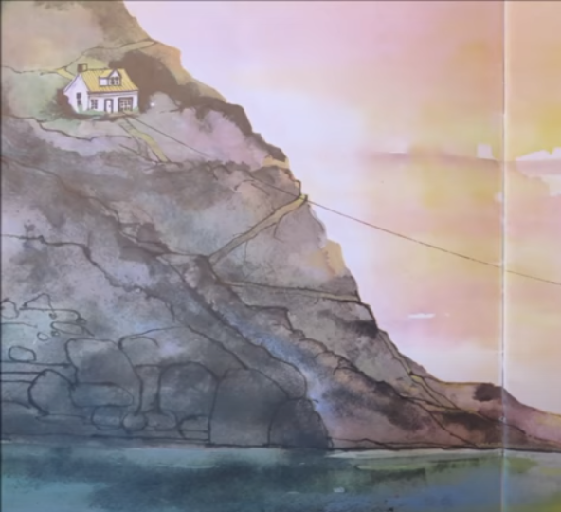
Nouns
Cottage,
cliff,
wire,
rocks,
sea,
clouds
seaweed
Adjectives
Steep, high,
cosy, white
Cloudy, yellow,
Calm, wet, deep, cold, blue
Verbs, perched, sitting
Hanging, swaying
Lapping, bobbing, floating

Slide 3
Looking at the cliff tops
There is a little, white cottage sitting perched on the edge of a steep, rocky cliff. The cold, blue sea below is calm today with water lapping gently against the rocks. The green seaweed floats in and out under the yellow cloudy sky.

Slide 4
Nouns
Adjectives
Verbs

Slide 5
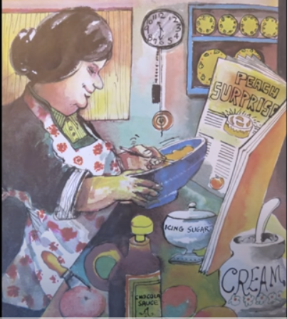
Nouns
Adjectives
Verbs

