Slide 1
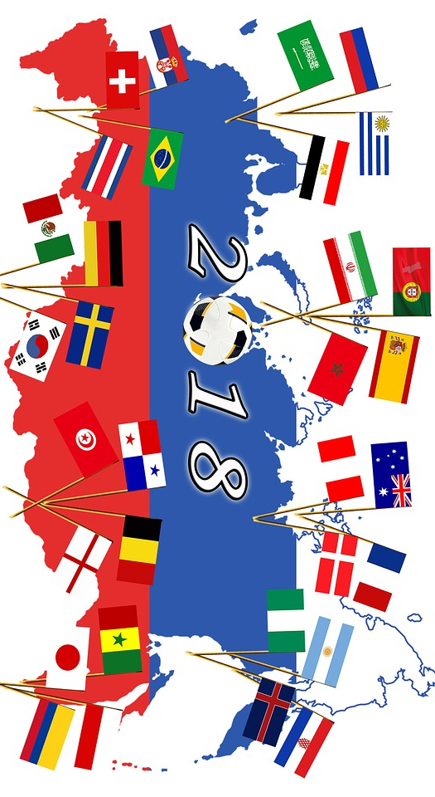
IDENTIFY ALL 32 PARTICPATING COUNTIRES IN THE 2018 FIFA WORLD CUP
EXTENSION: Can you name any of the capital cities?
Country / Capital City
Notes:
https://pixabay.com/en/football-world-championship-3373557/

