Slide 1
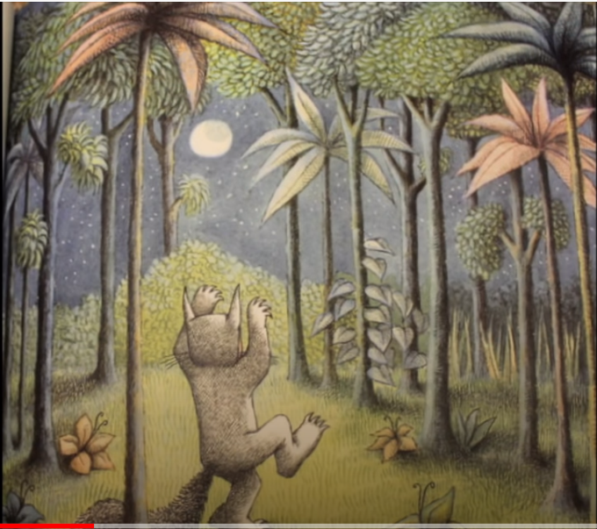
Monday 11th January – English Describing a scene.
Noun
vines

Slide 2
Noun adjective
Vines tall

Slide 3
Noun adjective verb
Vines tall winding

Slide 4
Max saw tall vines winding around the trees.

