Slide 1
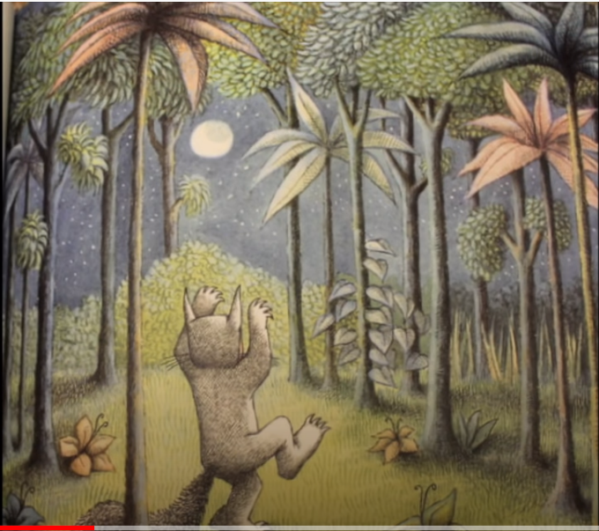
Monday 11th January – English Describing a scene.

Slide 3
Max can see a shiny moon.

