Slide 1
INTRODUCTION TO PHYSICAL AND HUMAN GEOGRAPHY
Wednesday 20.01.20

Slide 2
Learning Intention:
We are learning to define and identify the human and physical features of our local area.
Success Criteria:
I can explain the difference between a human and physical feature
I can sort the features and place them under the correct heading

Slide 3
Definitions
A physical feature is something which is natural – it happens naturally
E.g. land, water within a land, soil
A human feature is something man - made or it was made by a human being e.g. buildings

Slide 4
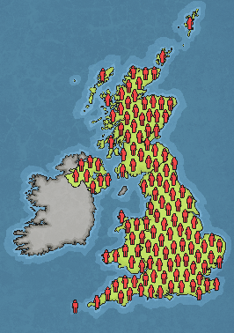
Human and Physical Geography
Human Geography
Physical Geography
Human geography relates to human activity or something that is humanly-constructed.
Physical geography relates to geography that is naturally occurring.
It studies the interaction between human activity and the planet.
It studies the natural environment and landscapes of our planet.
Human geography might answer questions like:
Physical geography might answer questions like:
What is the largest city in Africa?
Why is the UK population growing?
Why do we experience global warming?
What happens when a volcano erupts?
Why does a river flood?
How are mountains formed?

Slide 5
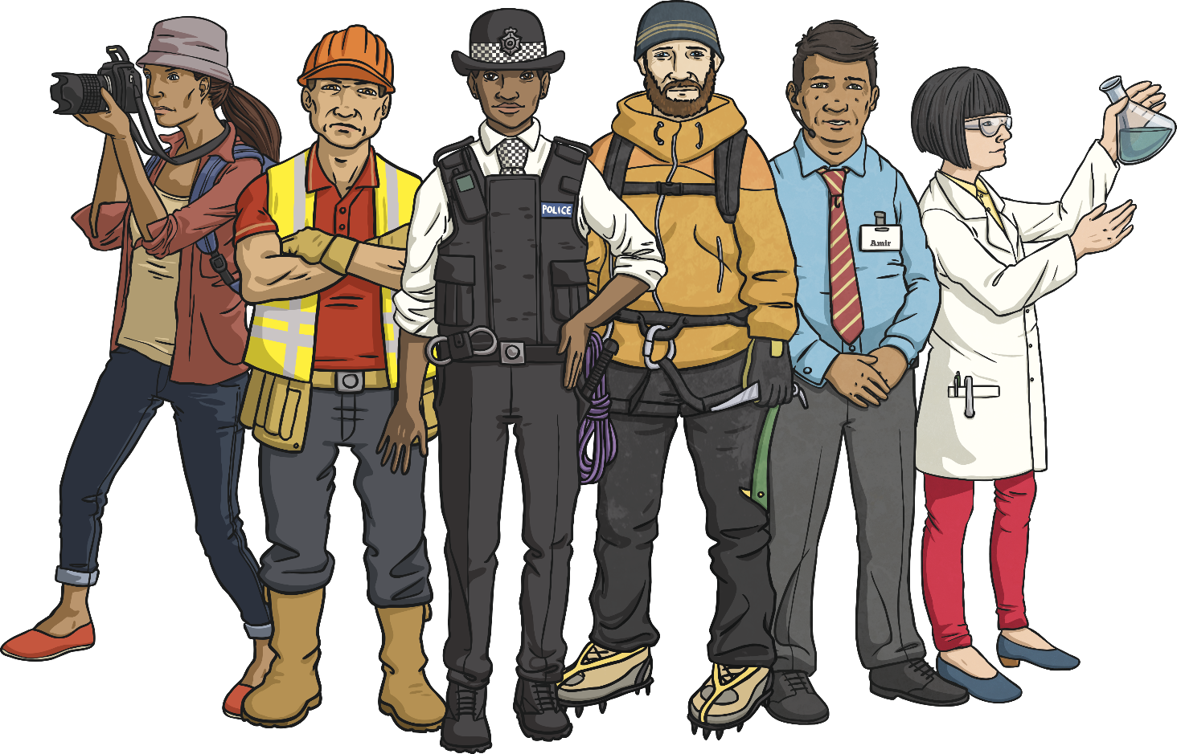
What Might You Study When Looking at Human Geography?
Human geography relates to human activity or something that is
humanly-constructed.

Slide 6
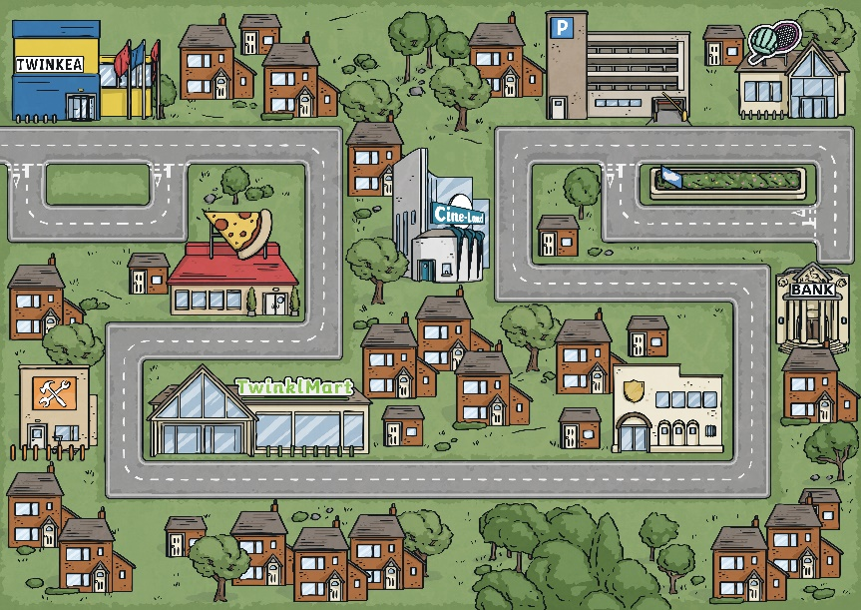
Human Geography
Settlements
Settlements are places where people live and work.
They can vary in size and have different populations, from tiny hamlets to large, sprawling cities.
Studying settlements can also include looking at features, such as homes, schools, shops, parks and libraries.

Slide 7
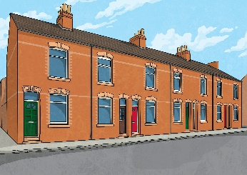
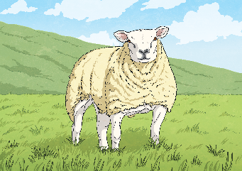
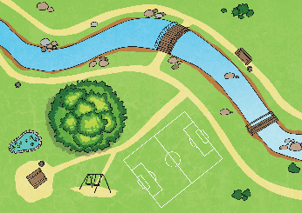
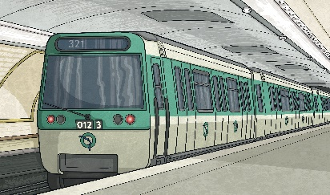
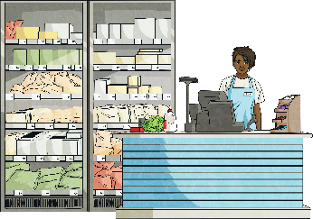
Human Geography
Land Use
Land use is when humans use an area of land for a specific purpose to meet their wants and needs.
The land may be used as it naturally exists or changed to fulfil a particular role.
There are five main types of land use.
residential
agricultural
recreational
transport
commercial

Slide 8
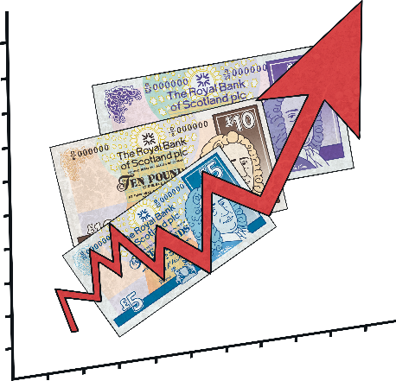
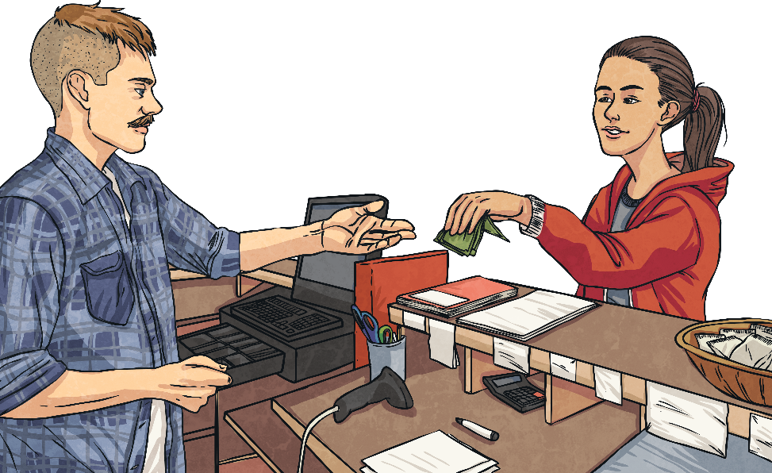
Human Geography
Economic Activity
Economy relates to how good a place is at producing and making goods and how much money it has (its wealth).
When we study economic activity, we look at the amount a country sells and makes, as well as their trade links with other areas.
This can affect the country’s wealth and other factors, such as employment and housing.

Slide 9
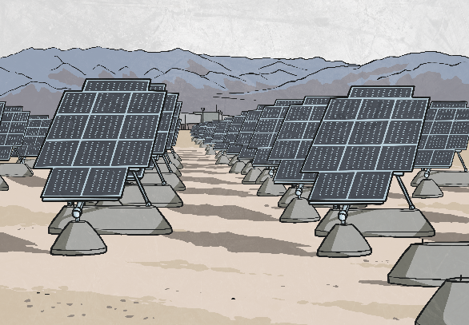
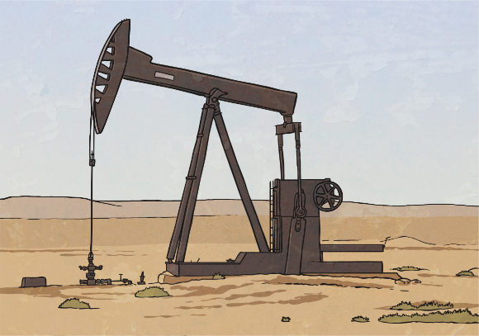
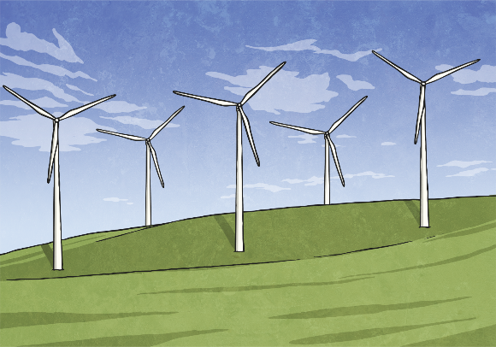
Human Geography
Energy Resources
When we study energy resources, we look at what opportunities an area of land offers to generate electricity.
Some areas of land might contain fossil fuels, such as coal, oil or gas.
Other areas have an ideal climate or landscape for harvesting renewable energy sources, such as solar, wind, hydroelectric or geothermal power.

Slide 10
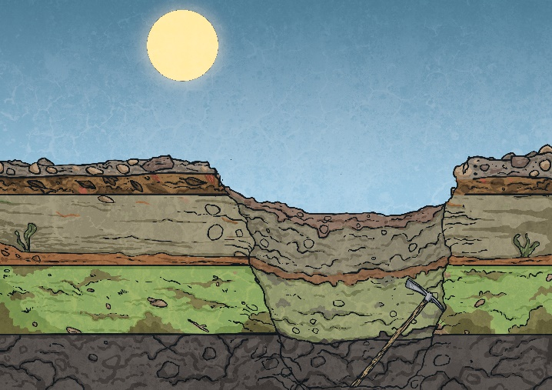
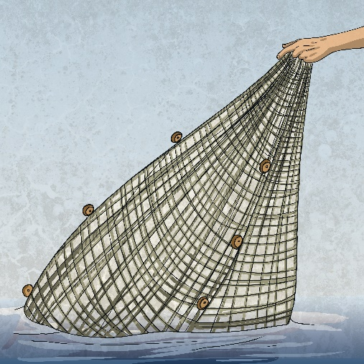
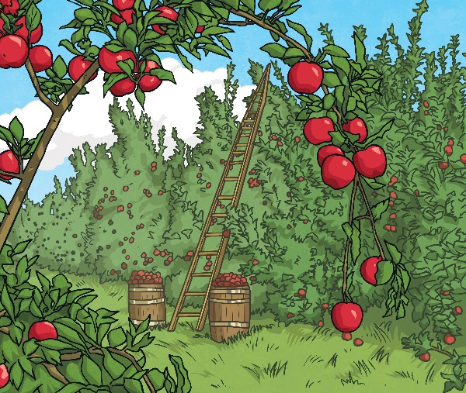
Human Geography
Resource Distribution
Humans rely on natural resources, such as food, water, energy and minerals for survival.
Different areas of earth have different amounts of each of these resources.
When we learn about resource distribution, we explore the ways in which humans make use of different resources and how the location of natural resources affects the way we live our lives.

Slide 11
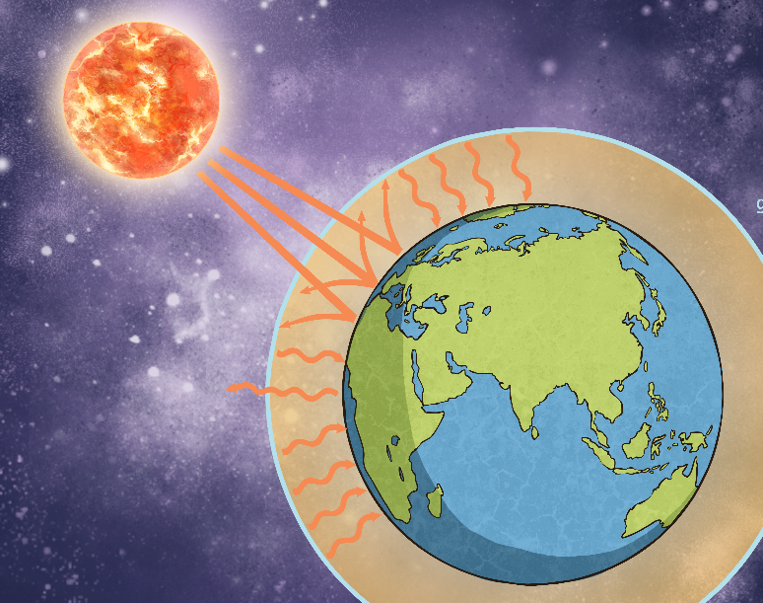
Human Geography
Climate Change
Climate change is sometimes called global warming. It is the process of our planet heating up.
We study the human causes of climate change and the effect it has on the planet.
Learning about climate change also involves exploring possible solutions to the problem.

Slide 12
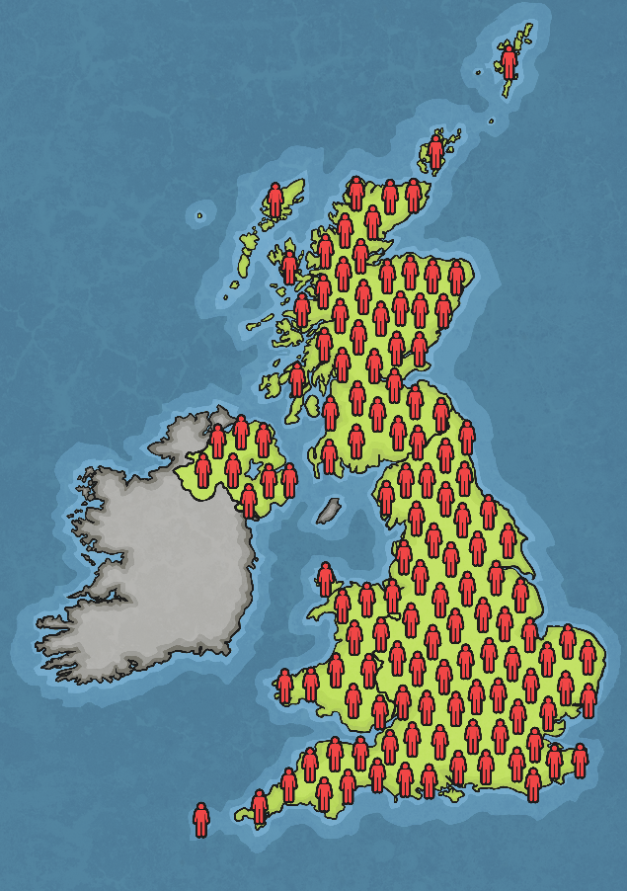
Human Geography
Population
Population means the number of people who live in a specific area.
Populations change over time and the population of Earth is growing rapidly.
In geography, we explore possible reasons for changes in a place’s population, for example births, deaths or migration.

Slide 13
What might you study when looking at Physical Geography?
Physical geography relates to geography that is naturally occurring.

Slide 14
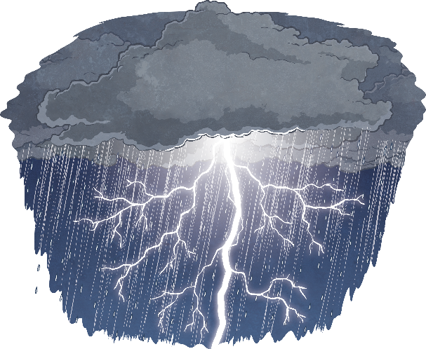
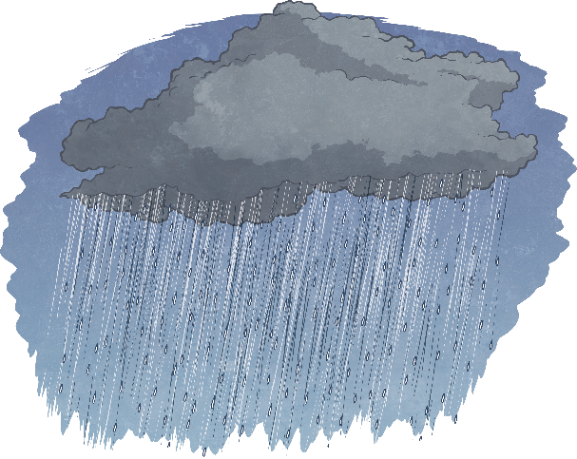
Physical Geography
Weather
Weather refers to the state of the atmosphere in a particular place.
When we study weather, we are thinking about elements, such as the temperature, how wet or dry it is, the wind levels or whether there are any storms.
An area’s average weather, over approximately 30 years, is described as its climate.

Slide 15
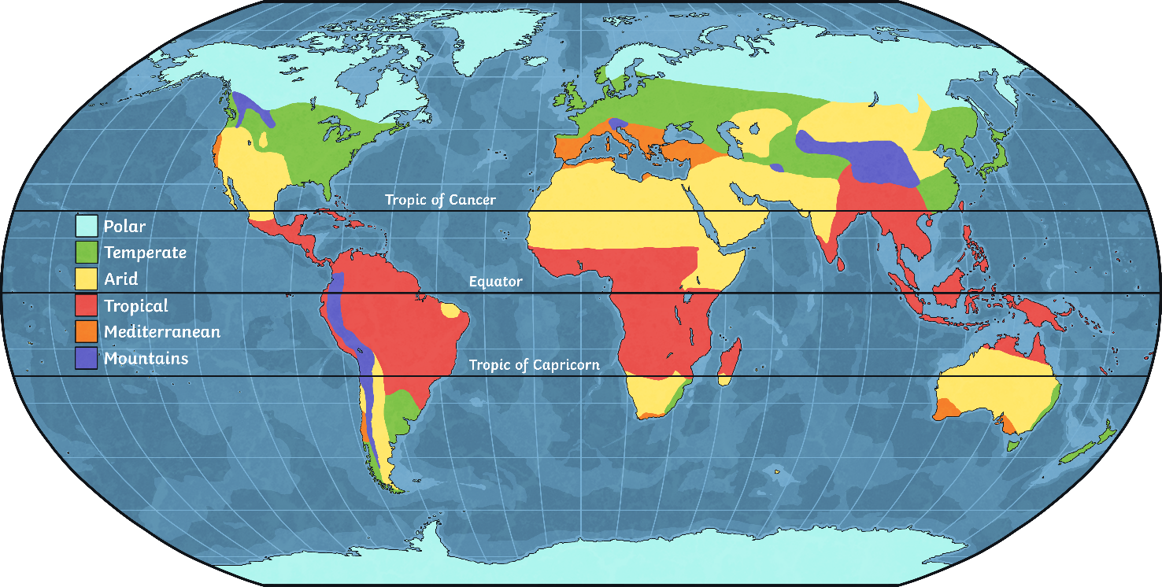
Physical Geography
Climate Zones
Climate zones are parts of the world where there are similar weather patterns.
Studying climate zones involves learning about the patterns of weather experienced in different parts of our planet and exploring the reasons behind them.

Slide 16
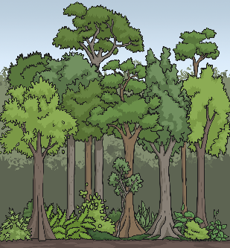
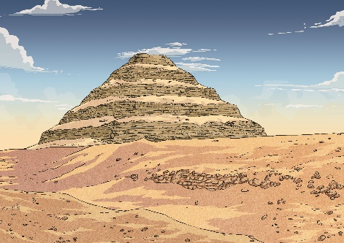
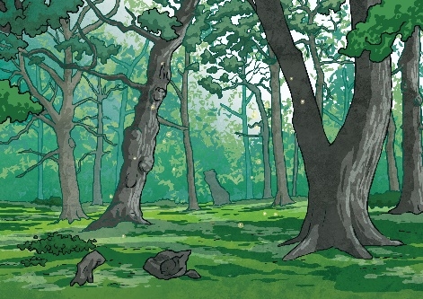
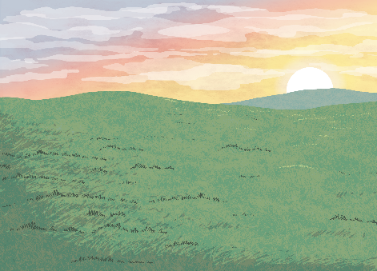
Physical Geography
Biomes
Biomes are parts of our planet with similar climates, landscapes, animals and plants.
When we study biomes, we explore elements, such as temperature, rainfall and soil, to help us understand which plants and animals might live there.
Some different types of biomes include rainforests, deserts, woodland and grasslands.

Slide 17
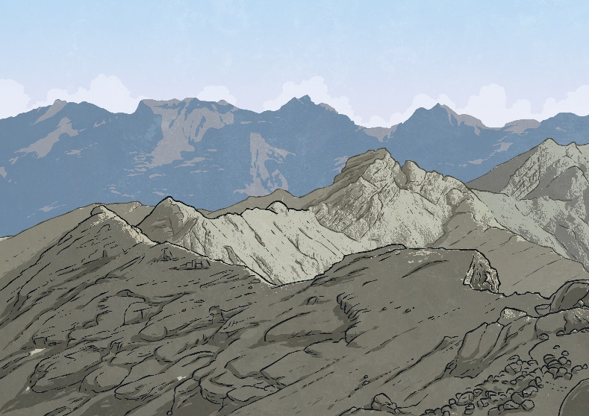
Physical Geography
Mountains
Mountains are areas of land that are usually over 600 metres high. They are often higher and steeper than hills.
When we learn about mountains, we explore how they are formed and where they are located on our planet.
Studying mountains can link to learning about tectonic plates, volcanoes and the layers of the earth.

Slide 18
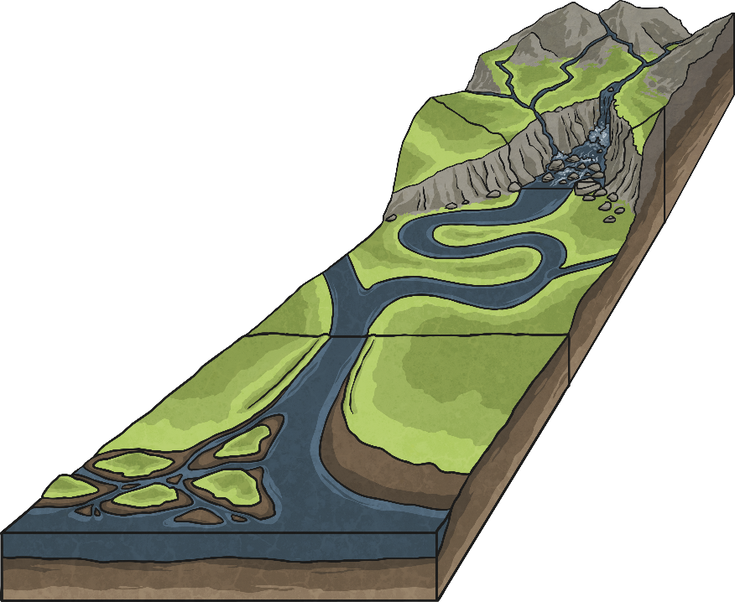
Physical Geography
Rivers
Rivers are large, natural streams of water. They flow downhill, along a channel, from their source to a sea, lake or another river.
Studying rivers involves learning about how they are formed and the different ways they might flow through changing landscapes.
You might also explore how rivers can erode land over time.

Slide 19
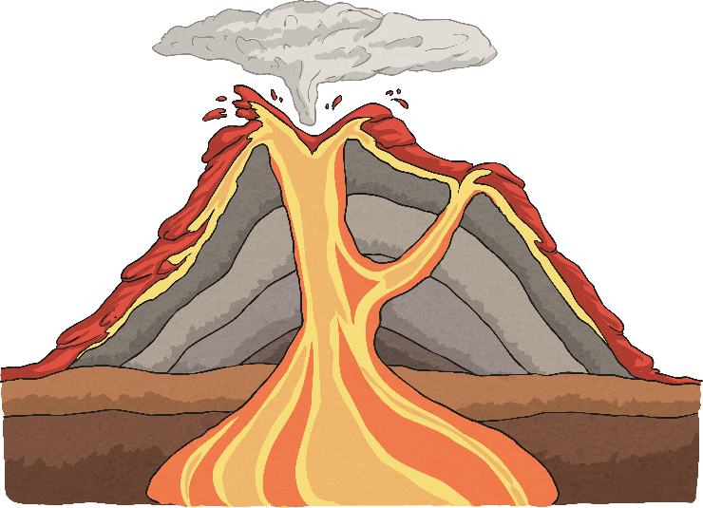
Physical Geography
Volcanoes
A volcano is a mountain or hill with an opening where lava, gases and rock fragments can escape from.
Studying volcanoes involves exploring how they are formed, where they are located and the different types of volcanic eruptions.
Learning about volcanoes is often linked to other areas of geography, including the layers of the earth, tectonic plates, mountains and earthquakes.

Slide 20
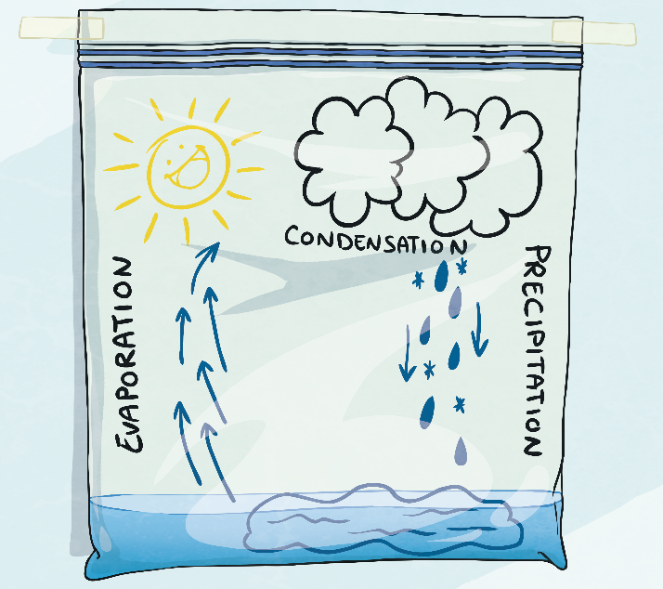
Physical Geography
The Water Cycle
The water cycle describes the constant recycling of all water on Earth.
Water moves in a continuous cycle between the land, oceans and atmosphere.
When we study the water cycle, we learn about the sequence of evaporation, condensation, transpiration, precipitation (rain or snow) and collection.

Slide 21
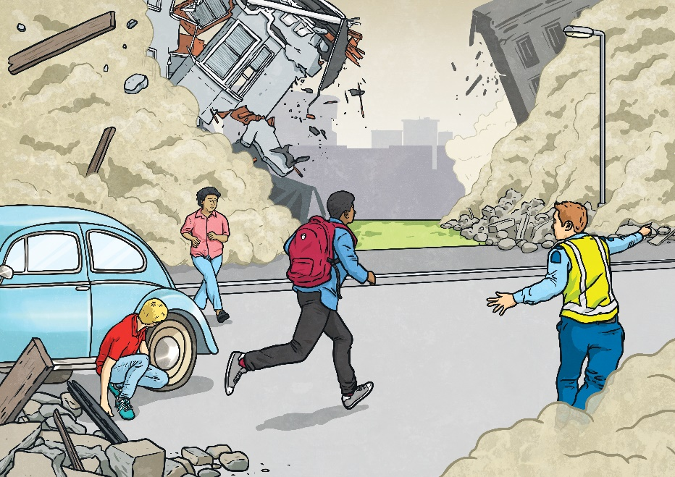
Physical Geography
Earthquakes
Earthquakes occur when the plates of the earth’s upper layer (the crust) move and release stored energy. The sudden and intense shaking often results in much damage.
We learn about what causes earthquakes, where they occur, how they are measured and the destruction they can cause.
Earthquakes are linked to our learning about the earth’s layers, tectonic plates and volcanoes.

Slide 22
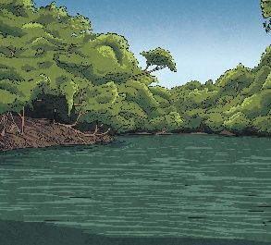
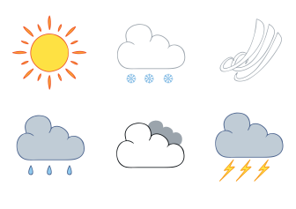
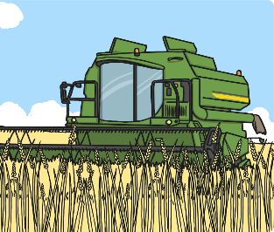
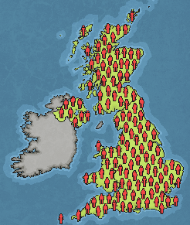
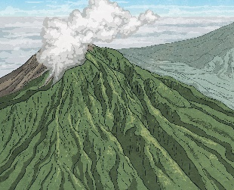
Geography
Are these examples of human or physical geography?
Can you explain why?
weather
rainforests
rivers
towns and cities
farming
population
volcanoes

Slide 23
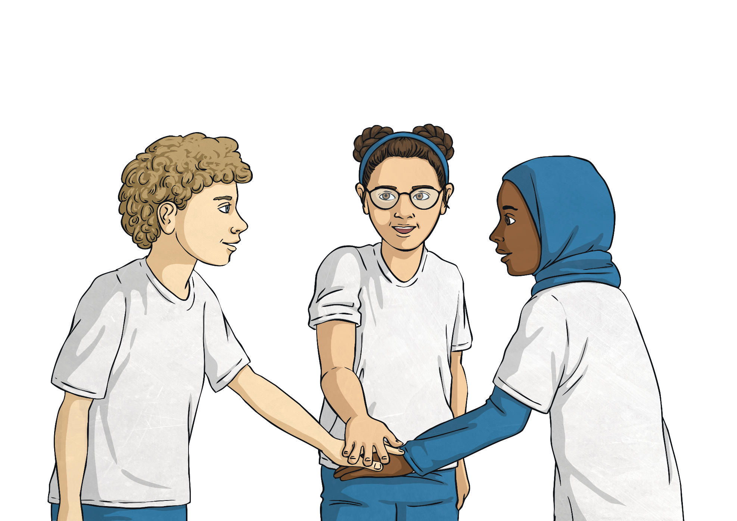
Think About It
Take a look at the photos on the next few slides and decide if they show human or physical geography. Be careful - some images may show examples of both!

Slide 24
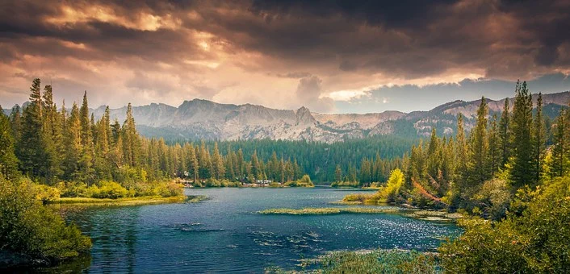
Quiz Challenge
Look at the photo.
Is this an example of human or physical geography?
What aspect of physical geography might you be learning about? It could be more than one!

Slide 25
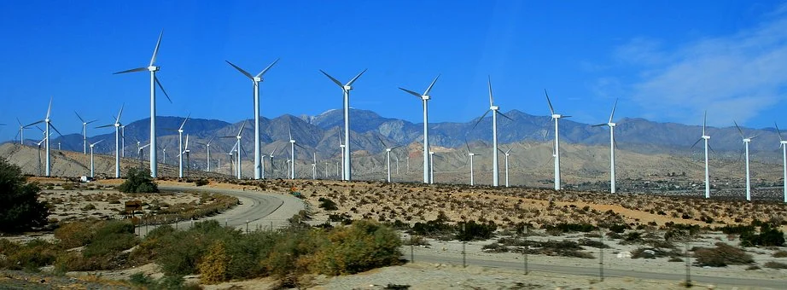
Quiz Challenge
Look at the photo.
Is this an example of human or physical geography?
What aspect of human geography might you be learning about? It could be more than one!

Slide 26
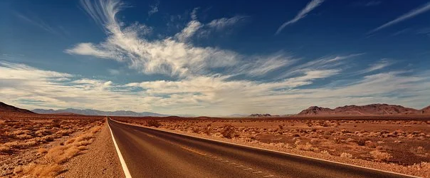
Quiz Challenge
Look at the photo.
Is this an example of human or physical geography?
What aspect of human or physical geography might you be learning about? It could be more than one!

Slide 27
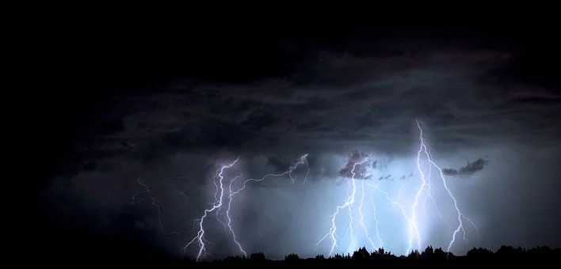
Quiz Challenge
Look at the photo.
Is this an example of human or physical geography?
What aspect of physical geography might you be learning about?

Slide 28
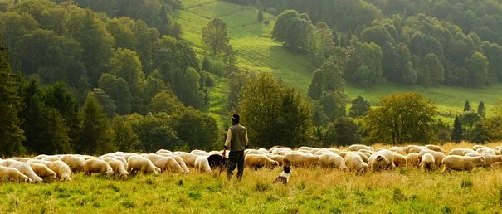
Quiz Challenge
Look at the photo.
Is this an example of human or physical geography?
What aspect of human geography might you be learning about? It could be more than one!

Slide 29
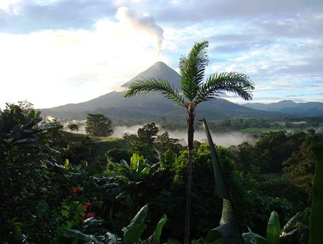
Quiz Challenge
Look at the photo.
Is this an example of human or physical geography?
What aspect of physical geography might you be learning about? It could be more than one!

Slide 30
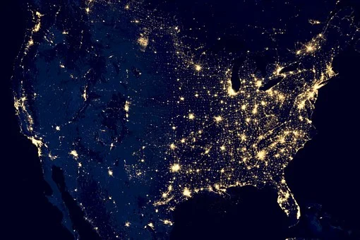
Quiz Challenge
Look at the photo.
Is this an example of human or physical geography?
What aspect of human geography might you be learning about? It could be more than one!

Slide 31
Geographical skills: photo interpretation
Atmosphere
cloud
Tree
mountain
River
Rock
vegetation

Slide 32
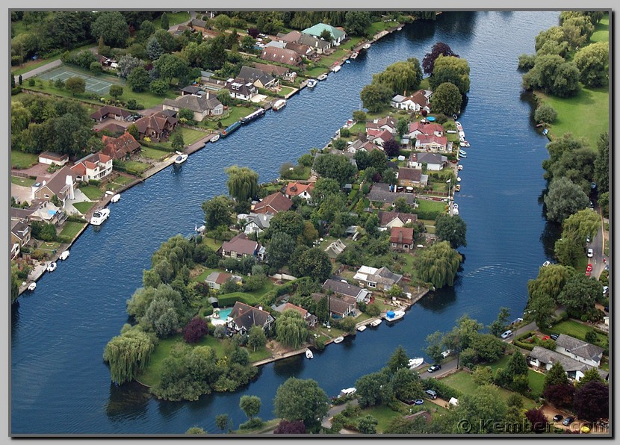
Photograph A

Slide 33
Answers for photograph A
Physical features Human features
Trees Houses/buildings
Fields/grassed areas Roads
River Tennis courts

Slide 34
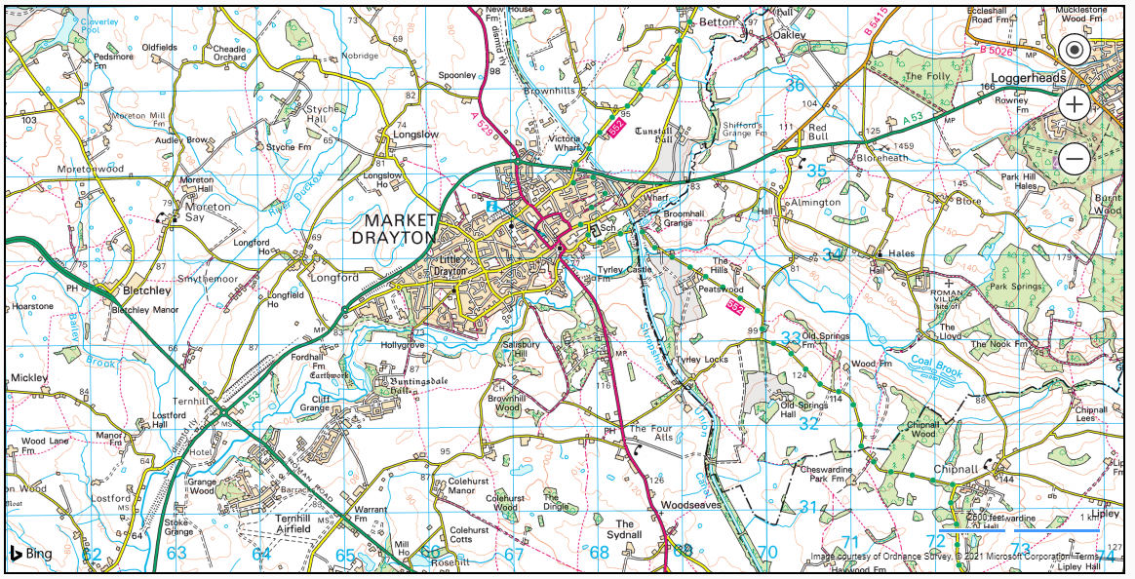
Task
IDENTIFY THREE PHYSICAL and HUMAN FEATURES FROM THE MAP

