Slide 1
What do you already know about Rocks?
What are rocks?
What rocks are in your local area?
What are the three main types of rock?
Are all rocks the same?
How do rocks form?

Slide 2
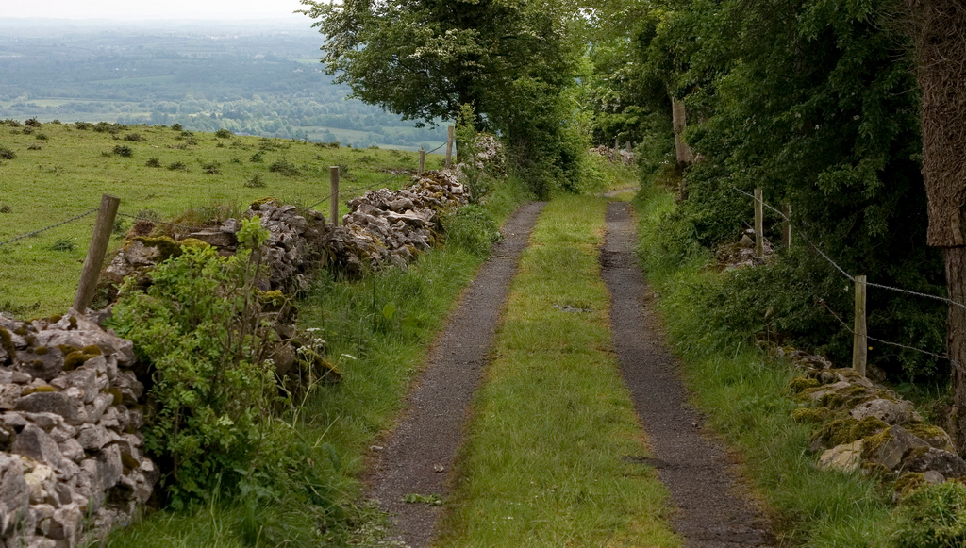
Spot the Rocks Countryside

Slide 3
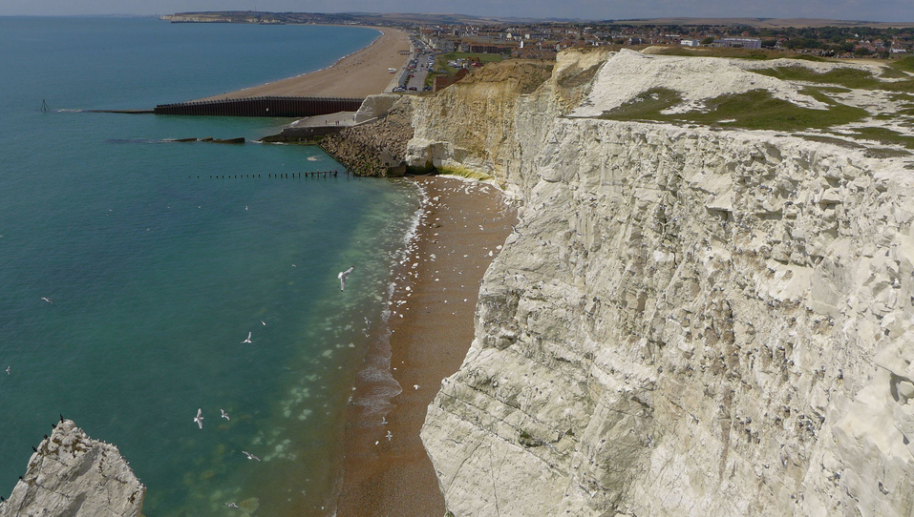
Spot the Rocks Chalk Cliffs

Slide 4
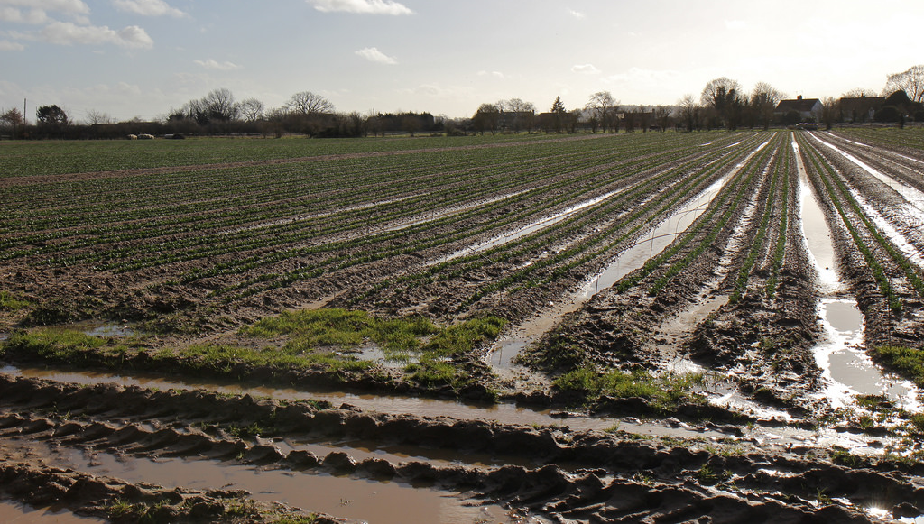
Spot the Rocks Muddy Fields

Slide 5
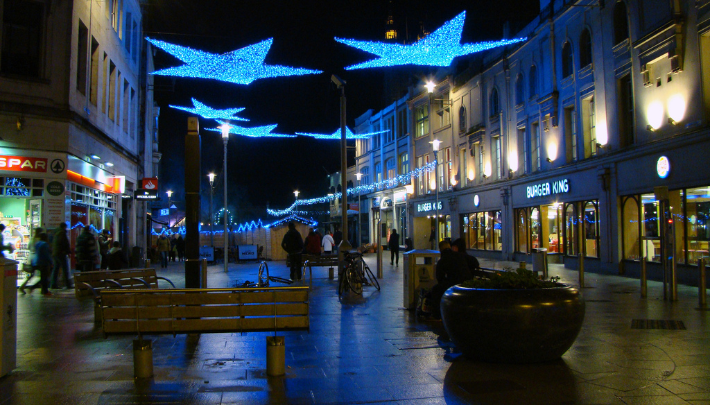
Spot the Rocks Town Centre
Photo courtesy of joncandy (@flickr.com) - granted under creative commons licence – attribution

Slide 6
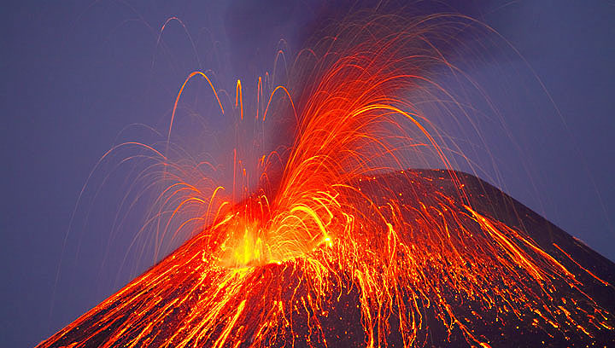
Spot the Rocks Volcano

Slide 7
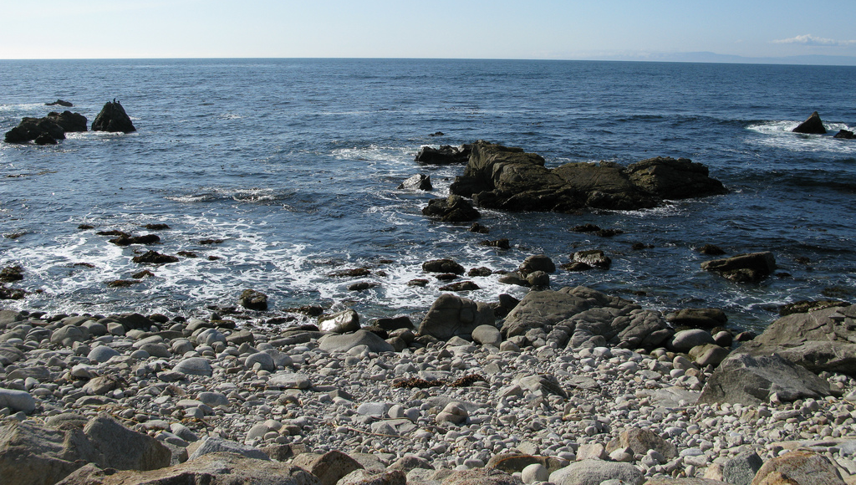
Spot the Rocks Beach

Slide 8
What Types of rock are in our local area?

Slide 9
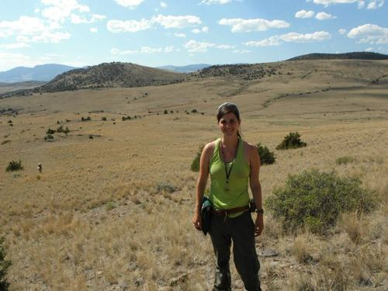
Urgent Message from Leading Petrologist Dr Sarah Stone from the British Rock Society (BRS)

Slide 10
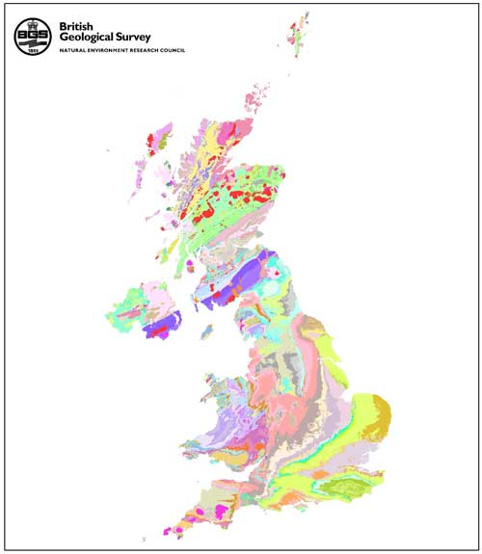
In the last few days our data base has crashed. We have lost a lot of information on the many different types of rock that lie beneath Britain and how rocks are used in different places.
This information has been gathered by scientists over many years and the data is very important.
We do not have time to send BRS petrologists to every area of Britain to find the information we need so we are having to ask local scientists to help.

Slide 11
Thankfully lots of scientists are getting involved by carrying out a rock survey in their local area to get back the data we need. However we have not managed to find anyone able to do it in your area.
We need people who understand about how rocks are formed and have some expert knowledge on petrology.
Your teacher has told me that you are a very clever and hard working class who have already learnt a lot about rocks – you probably already know more about this fascinating subject than many grown ups!
Please would you do a rock survey around your local area for the BRS?

Slide 12
If the answer is YES, continue through this message to find out about your task

Slide 13
There are many different types of rock across Britain. Any rock that lies below the soil is called the“bedrock.” You will be trying to discover what the bedrock is in your local area.
There will be clues to what this rock might be. Try to look at old buildings, e.g. churches and old cottages. It is very likely that these are built from the local rock in your area.

Slide 14
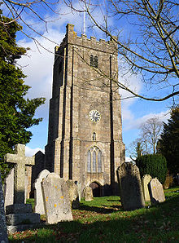
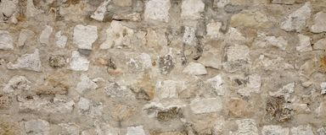
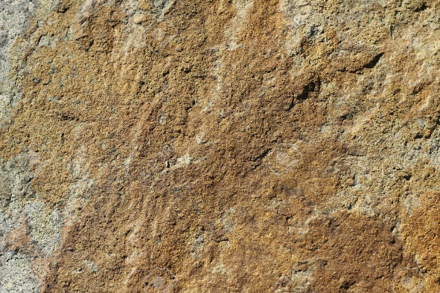
Look for old buildings made of rock, take photos of the building and close up photos of the rock.
If you can, name the rock that it is made of but do not worry if you can’t. Describe it’s colour, texture and features, e.g. are there layers, crystals or grains? Your photos and notes will help our experts get the data they need.

Slide 15
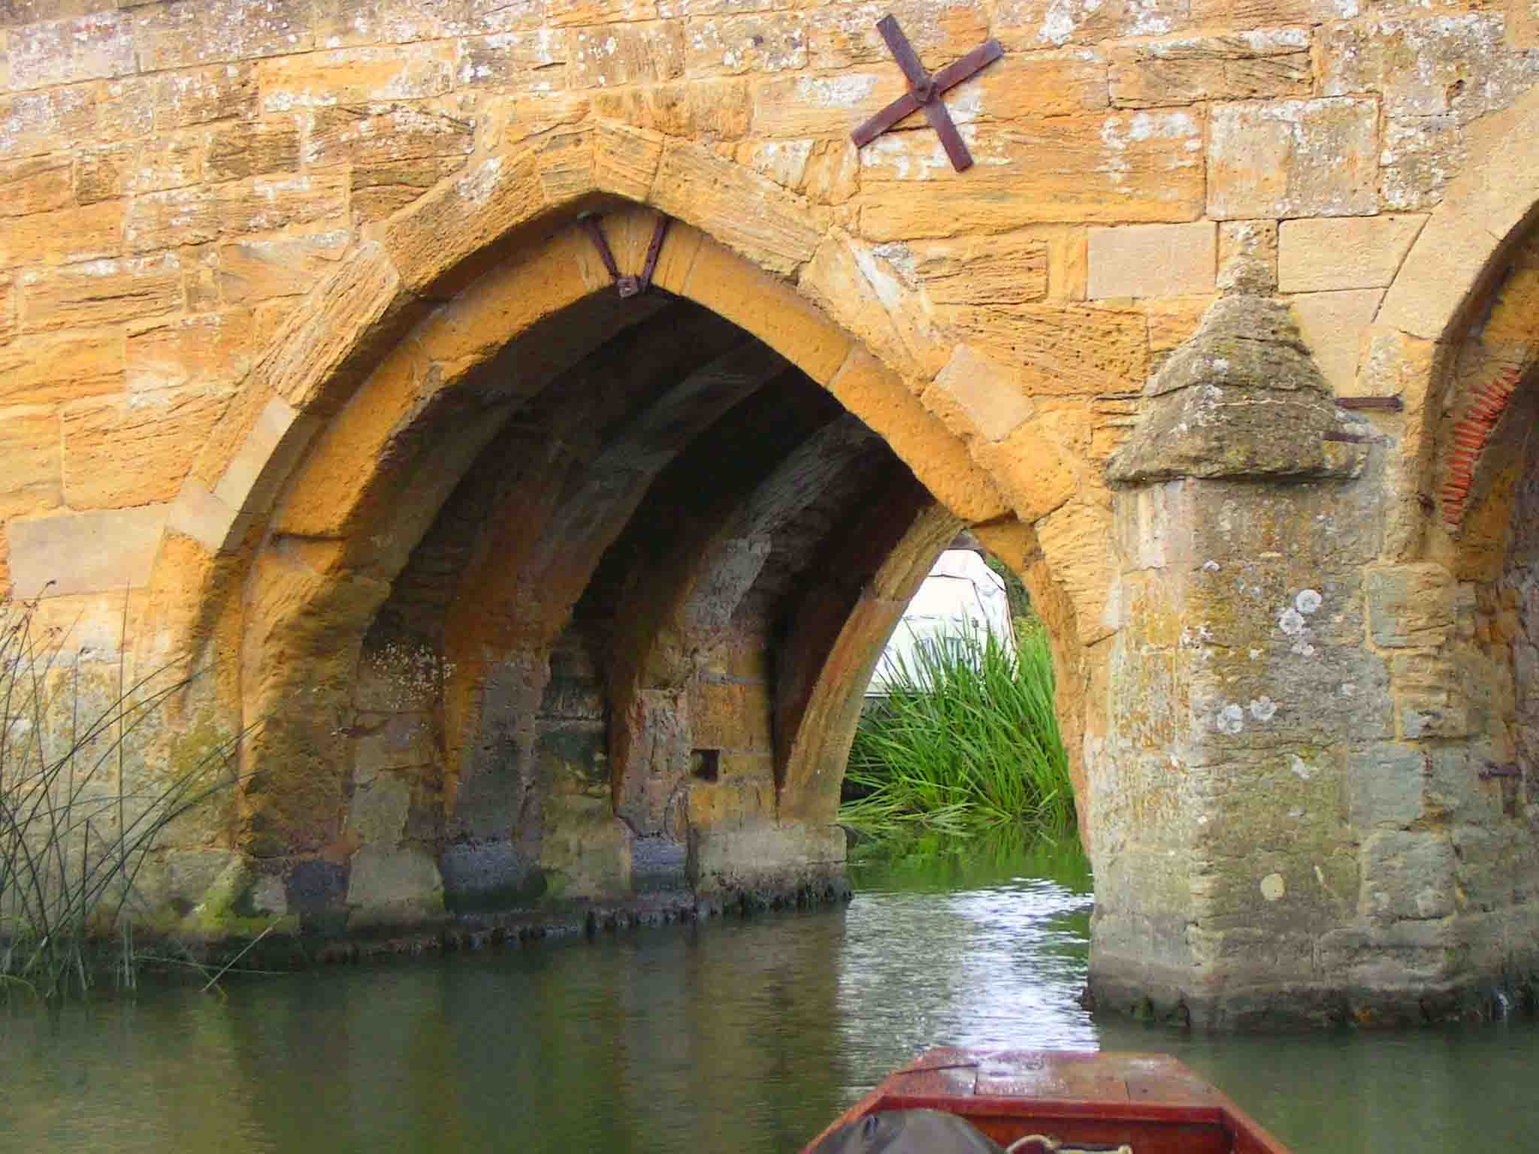
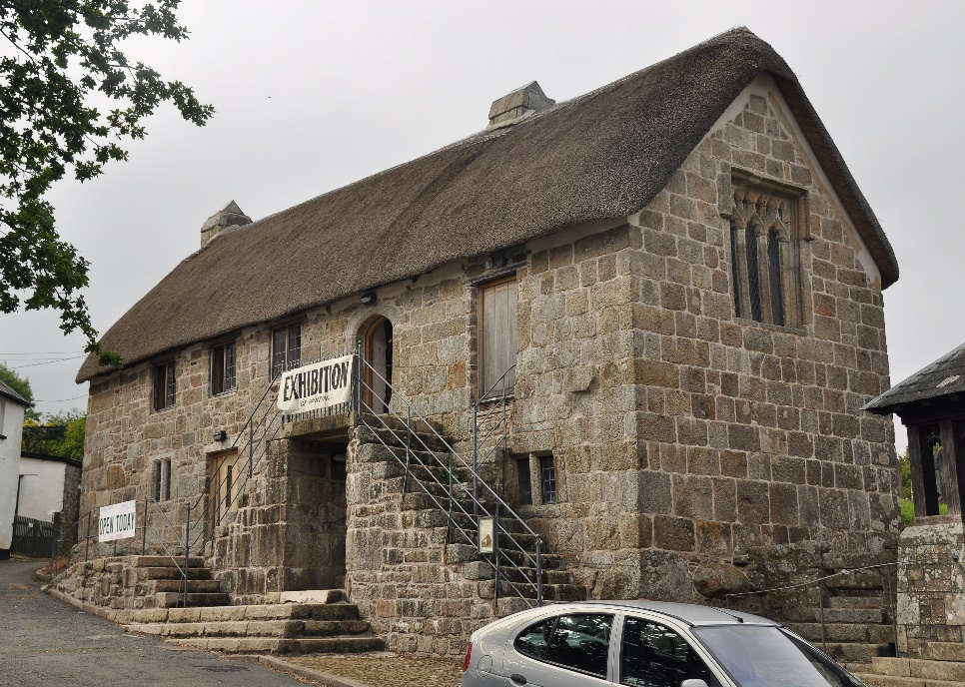
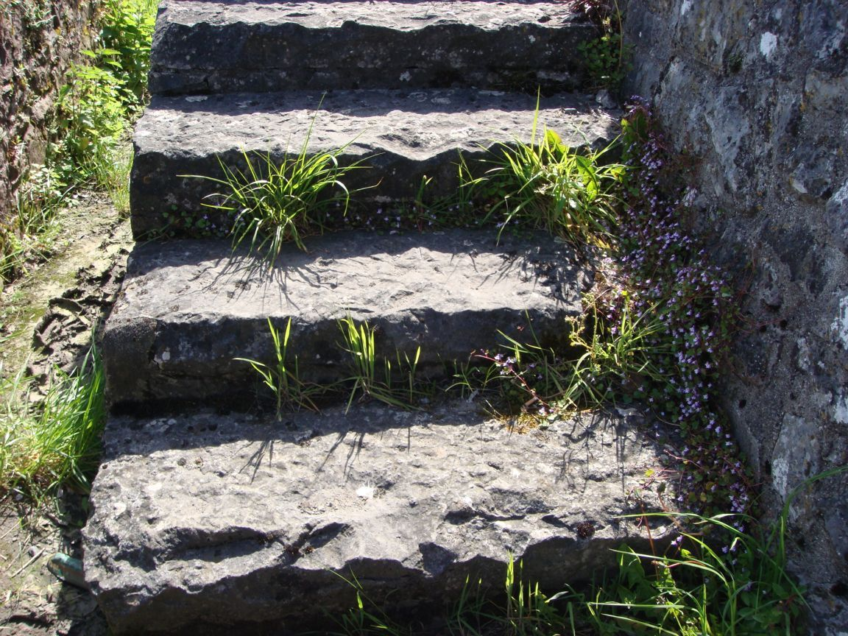
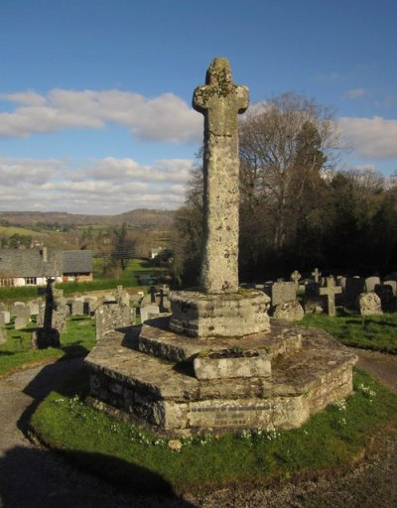
You will get clues about your local stone from old buildings, bridges, steps and monuments. Gather evidence from these.

Slide 16
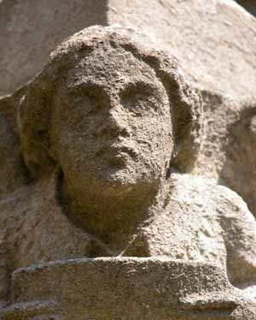
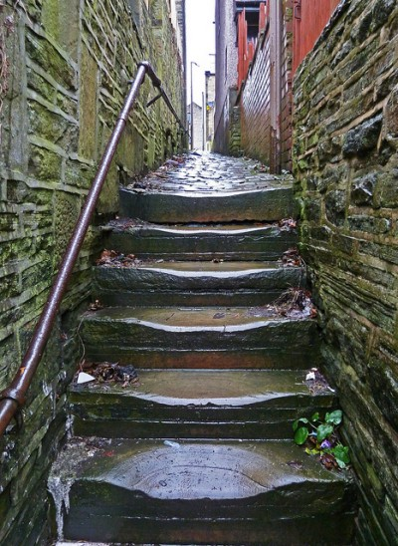
Look for evidence of rocks that are wearing away (erosion) which might be caused by wind and rain or by people’s feet. Take photos and make notes.

Slide 17
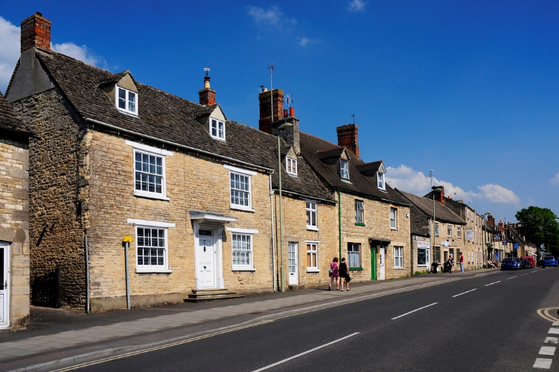
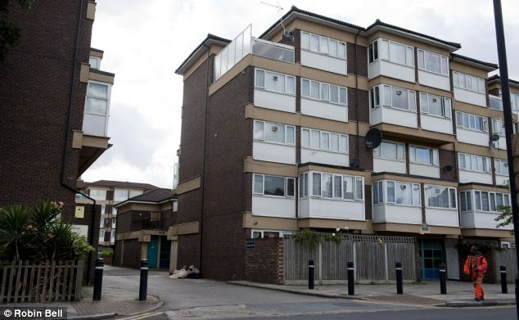
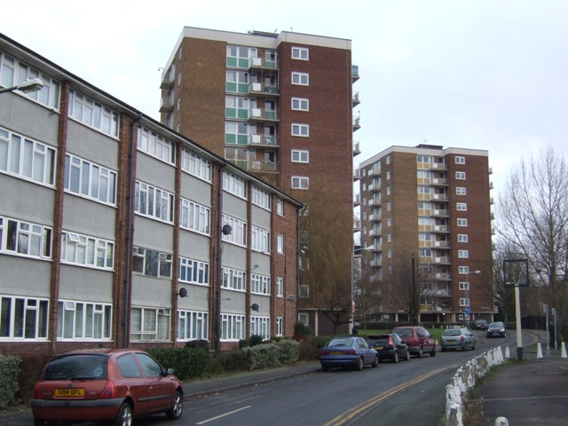
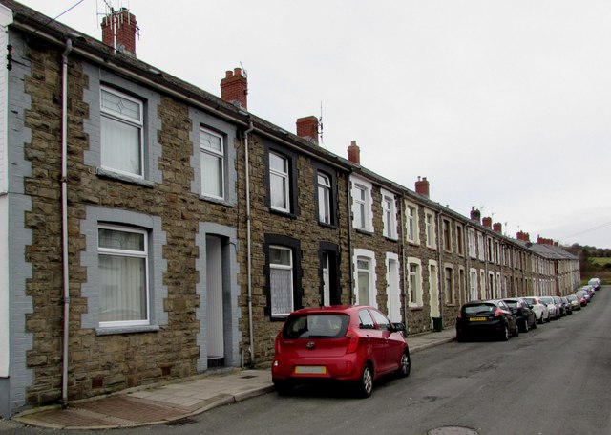
Please could you also look at houses and homes in your area.
Are they made of man-made rocks like brick or concrete or natural stone?

Slide 18
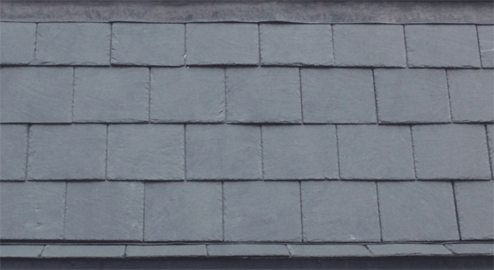
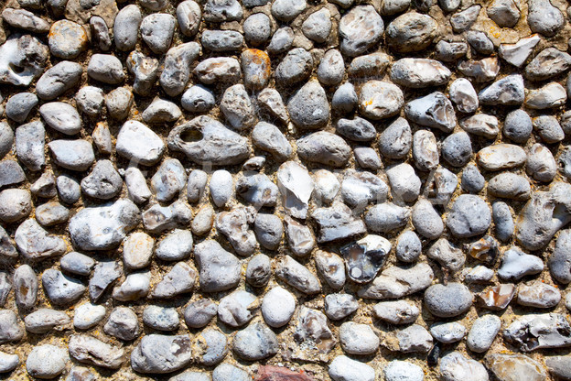
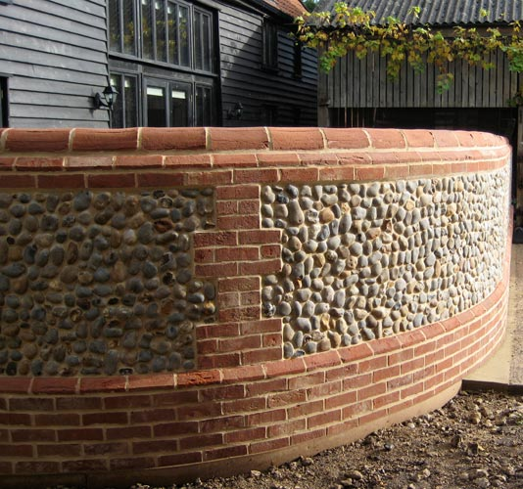
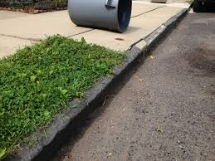
Also look around to see where different rocks may have been selected for different jobs. Take photos and make notes about what you see.
Think about why some rocks are particularly well suited to one job. Jot down your ideas.

Slide 19
Thank you so much for agreeing to do this! Your information will be crucial to our rock survey.
You will find the survey sheets to the school so they should be ready for you to begin.
Good Luck!

