Slide 1


Slide 3
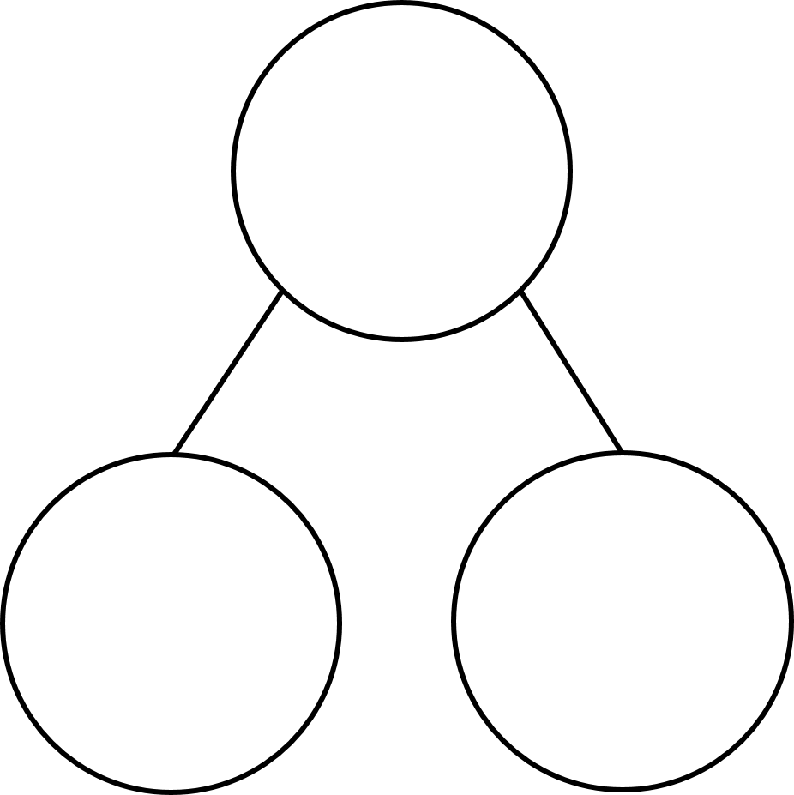

Complete the calculations
1)
3 $×$ 6 $=$ 3 $×$ 60 $=$
2) 5 $×$ 4 $=$ 5 $×$ 40 $=$
6 $×$ 4 $=$ 6 $×$ 40 $=$
3) Complete the part-whole models
30
27

Slide 4
Complete the calculations
1)
3 $×$ 6 $=$ 3 $×$ 60 $=$
2) 5 $×$ 4 $=$ 5 $×$ 40 $=$
6 $×$ 4 $=$ 6 $×$ 40 $=$
3) Complete the part-whole models
18
180
20
200
24
240
34
30
27
57

Slide 6

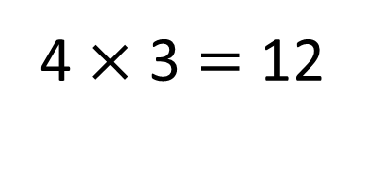
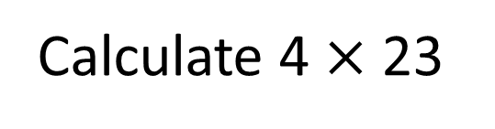
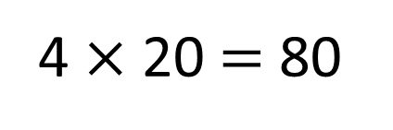
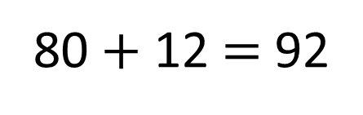
Calculate 4 $×$ 23
4 $×$ 20 $=$ 80
4 $×$ 3 $=$ 12
80 $+$ 12 $=$ 92

Slide 7

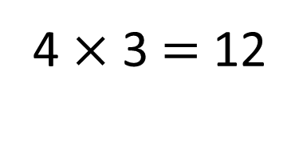
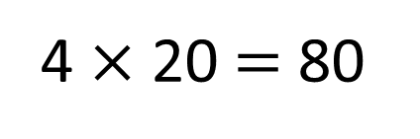
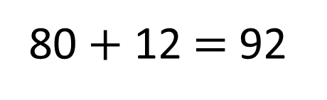
Calculate 4 $×$ 23
23
20
3
4 $×$ 20 $=$ 80
4 $×$ 3 $=$ 12
80 $+$ 12 $=$ 92

Slide 8

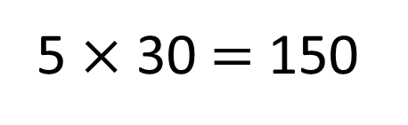
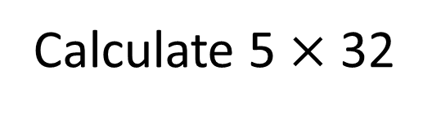
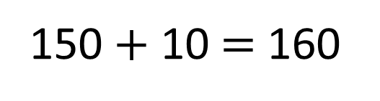
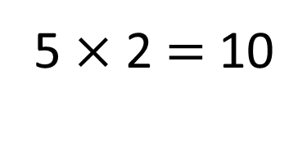
Calculate 5 $×$ 32
Have a think
32
30
2
5 $×$ 30 $=$ 150
5 $×$ 2 $=$ 10
150 $+$ 10 $=$ 160

Slide 9
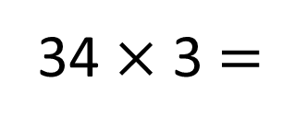
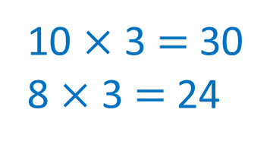
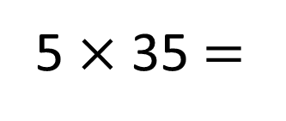
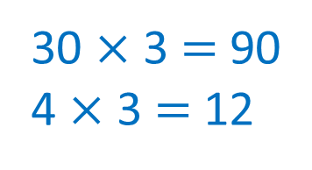
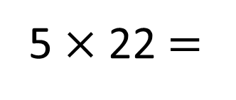
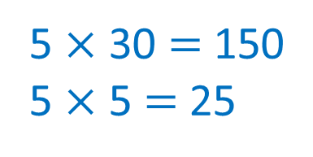
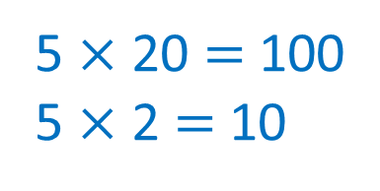
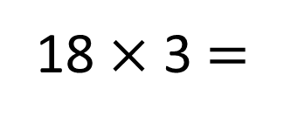
Calculate
Have a think
5 $×$ 22 $=$
110
5 $×$ 35 $=$
175
5 $×$ 20 $=$ 100
5 $×$ 2 $=$ 10
5 $×$ 30 $=$ 150
5 $×$ 5 $=$ 25
34 $×$ 3 $=$
102
18 $×$ 3 $=$
54
30 $×$ 3 $=$ 90
4 $×$ 3 $=$ 12
10 $×$ 3 $=$ 30
8 $×$ 3 $=$ 24

Slide 10


Arrange the digit cards into the calculation below.
3
4
5
Have a think
$$×$$
How many different totals can you make?
What is the greatest total you can make?
What is the smallest?
What do you notice? Does this always happen?

Slide 11
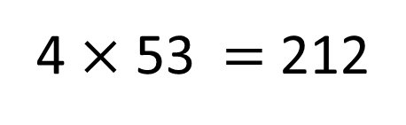
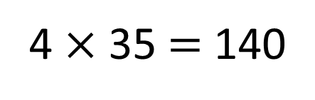

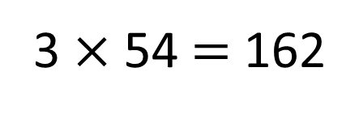
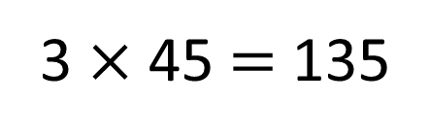
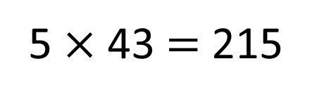
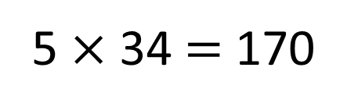
Arrange the digit cards into the calculation below.
3
4
5
$$×$$
3 $×$ 45 $=$ 135
4 $×$ 35 $=$ 140
5 $×$ 34 $=$ 170
3 $×$ 54 $=$ 162
4 $×$ 53 $=$ 212
5 $×$ 43 $=$ 215
6
How many different totals can you make?

Slide 12
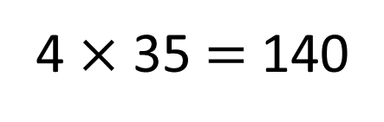
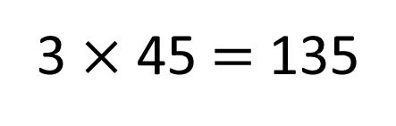
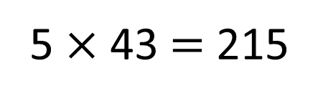
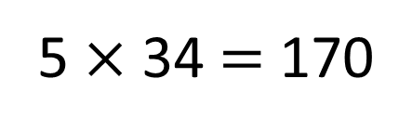
3
4
5
5
4
3
Placing the cards in ascending order gives the smallest possible total.
3 $×$ 45 $=$ 135
4 $×$ 35 $=$ 140
5 $×$ 34 $=$ 170
Placing the cards in descending order gives the greatest possible total.
3 $×$ 54 $=$ 162
4 $×$ 53 $=$ 212
5 $×$ 43 $=$ 215
215
What is the greatest total you can make?
What is the smallest?
What do you notice? Does this always happen?
135

Slide 13

What if you used these cards?
2
6
4
Have a think
$$×$$
How many different totals can you make?
What is the greatest possible total?
What is the smallest?

Slide 14

Use 3 digit cards to complete the calculation below.
$× =$72
Have a think
Which 3 cards could you use?
Can you find more than one solution?

Slide 15
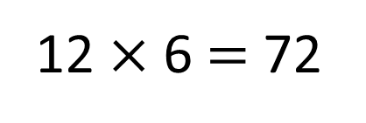
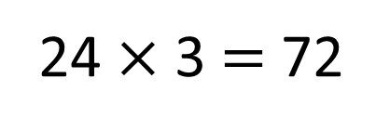
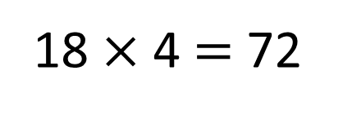
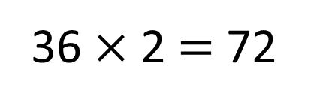

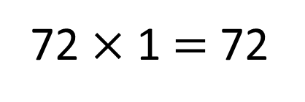
Use 3 digit cards to complete the calculation below.
$× =$72
72 $×$ 1 $=$ 72
36 $×$ 2 $=$ 72
12 $×$ 6 $=$ 72
24 $×$ 3 $=$ 72
18 $×$ 4 $=$ 72

