Slide 1
Counties of England
Source: https://en.wikipedia.org/wiki/Counties_of_England

Slide 2
Counties of England
Abbreviated counties
Greater Manchester South Yorkshire
Derbyshire Nottinghamshire
Staffordshire Leicestershire
Herefordshire Worcestershire
Warwickshire Northamptonshire
Cambridgeshire Bedfordshire
Gloucestershire Buckinghamshire
Oxfordshire Hertfordshire
© SaveTeachersSundays.com 2013

Slide 3
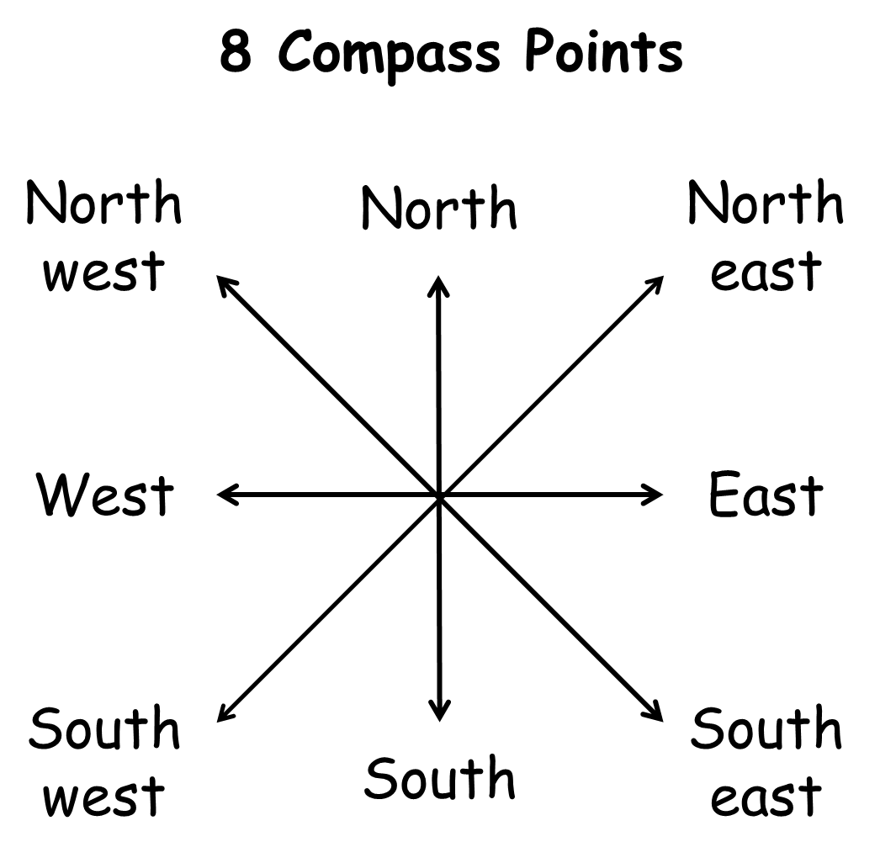

Slide 4
Name: Date: Locate the counties of England
Norfolk is north of .
Herefordshire is west of .
Buckinghamshire is east of .
Hampshire is south of .
Merseyside is bordered by , and .
Essex is of Hertfordshire.
Berkshire is of Greater London.
East Riding of Yorkshire is of Lincolnshire
Wiltshire is of Gloucestershire.
The most south-western county is .
The most south-eastern county is .
is bordered by East Sussex, Surrey and Hampshire.
West Yorkshire is south-west of .
Surrey is north-east of .
Somerset is north-west of .
The counties that border Scotland are and .
The counties that border Wales are , , and .
© SaveTeachersSundays.com 2013

Slide 5
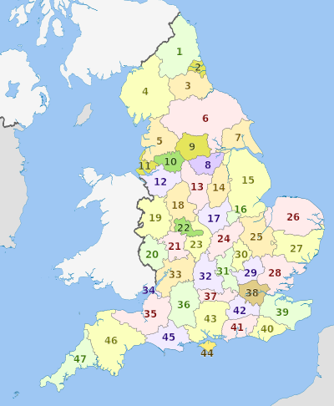
Counties of England
Source: http://commons.wikimedia.org/wiki/Category:Maps_of_counties_of_England

Slide 6
Counties of England
Source: http://commons.wikimedia.org/wiki/Category:Maps_of_counties_of_England

