Slide 1
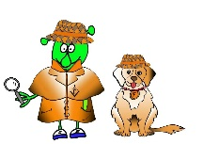
French Stage 1 Spring 1: Animals I like and don’t like
Language Detectives’ Memory Bank of Animals
Noun Bank
Un chat – a cat
Un chien- a dog
Un poisson – a fish
Un cheval- a horse
Un lapin- a rabbit
Un mouton – a sheep
Un serpent- a snake
Un oiseau – a bird
Une vache- a cow
Une souris- a mouse
Grammar
There are two words for “a”
in French.
These words are “un” and “une”
Sound spelling
“ch”
“oi”
Grammar
In French when we use “the” with a plural noun, we use the word “les”.
Fact Bank
In different languages animals make different noises. In French the noise a dog makes is “ouaf”.
Question and Answer Bank
J’aime .. – I like
Mon animal préféré est …. My favourite animal is….
Quel est ton animal préféré? – What is your favourite animal?

