Slide 1
WALT: To make predictions by exploring a book cover

Slide 2
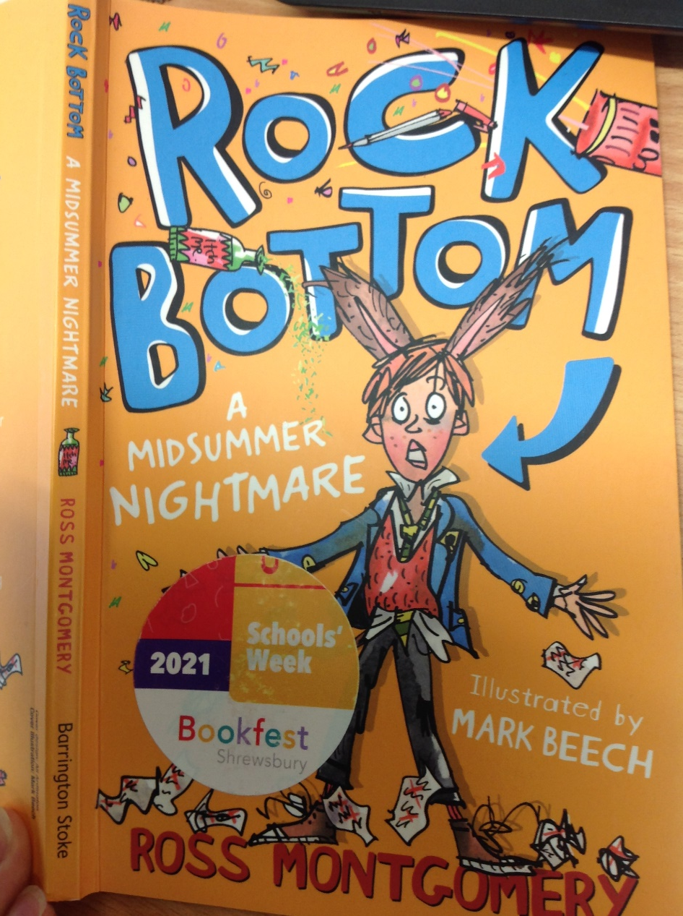
Are there any words that we are unsure of?
Characters?
Plot?
What information can we get from the title?
Setting?
Do the images tell us what genre the story is in?
Who is the main characters? Why do you think this?

Slide 3
What is your prediction for the plot for Rock Bottom?

Slide 4
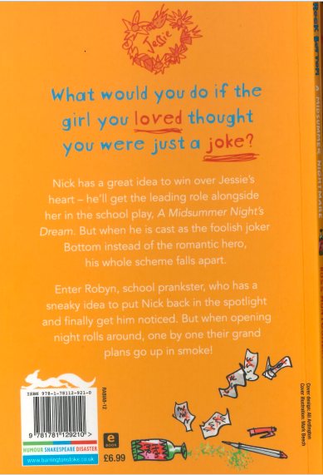
What can we now find out about the plot?
Who are the main characters? Why do you think this?
How is a Midsummer Night’s Dream involved?
How will Nick get noticed?
Are there any words that we are unsure of?
How will their plans go up in smoke?

