Slide 1
States of matter
Introduction to solids, liquids and gases

Slide 2
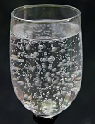
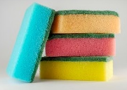
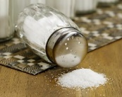
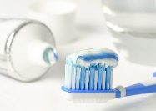
States of matter
Introduction to solids, liquids and gases
Learning Objective: to classify a range of objects and materials as solids, liquids or gases.
Activities
Useful items to support learning:
Fizzy water/drink and a glass.
Clean sponge or foam cloth and a bowl of water.
Household items such as jam, flour, sugar, milk, toothpaste and eggs (see p.5 for suggestions).
Key Learning
There are three states of matter: solid, liquid and gas.
A solid keeps its shape and has a fixed volume. Some solids are made up of small grains which can be poured into a heap.
A liquid has a fixed volume but changes in shape to fit the container. A liquid can be poured and keeps a level, horizontal surface.
A gas fills all available space; it has no fixed shape or volume.

Slide 3
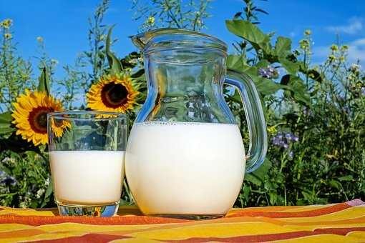
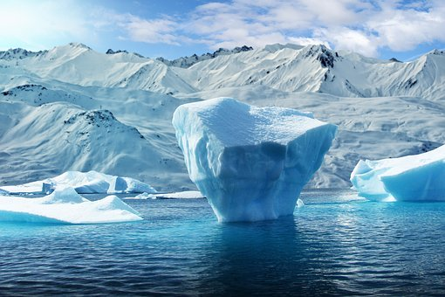
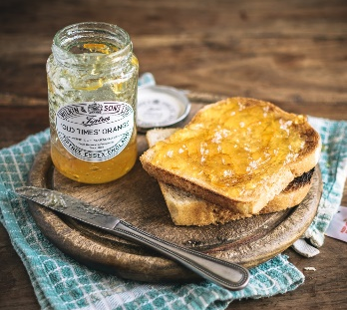
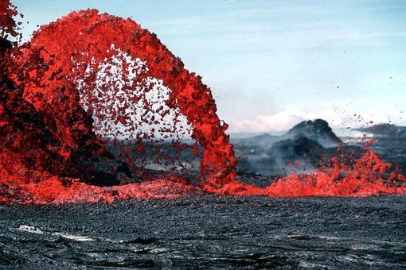
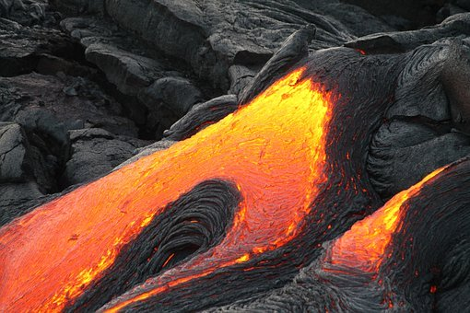
Explore, review, think, talk…
What do you already know about solids and liquids?
How would you describe the differences between a solid and a liquid? Watch this clip:
https://www.bbc.co.uk/bitesize/clips/zv4rkqt
Think about the differences between ice and water.
Is lava from a volcano a solid or a liquid?
Look at these pictures of some items you may have at home.
Think or talk about each item. Is it a solid or a liquid? How do you know?
Which items seem to be difficult to classify?
milk
glasses
fabric
salt
phone
toast
toothpaste
jam
soap

Slide 4
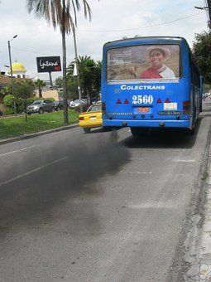
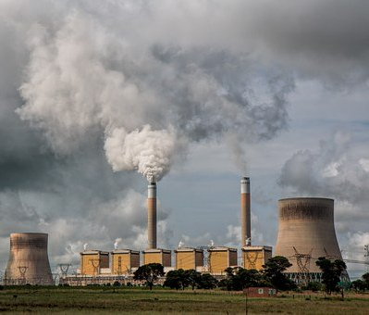
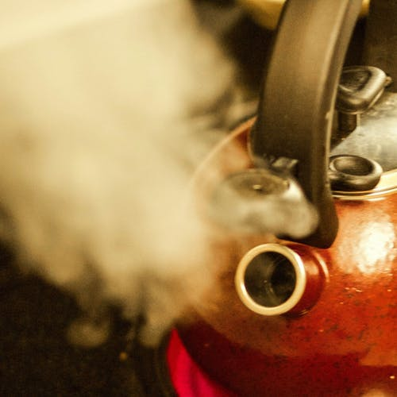
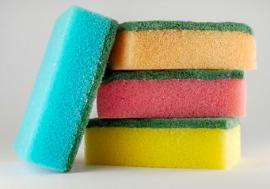
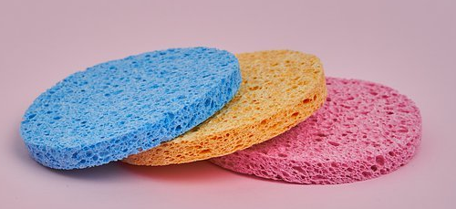
Solids, liquids and gases
Comparing the properties of solids, liquids and gases
(pages 4-7: 20 - 30 minutes)
Gases are often invisible but we can notice them when they are mixed with liquids or trapped within solids.
Where else can we notice gases? Watch this clip for clues: https://www.bbc.co.uk/bitesize/clips/zrdkjxs
Now use this BBC bitesize link to compare the properties of solids, liquids and gases. Use the descriptions to help with the next activity. https://www.bbc.co.uk/bitesize/topics/zkgg87h/articles/zsgwwxs
Pour out a glass of fizzy drink. You can see the carbon dioxide gas bubbles rising.
Squeeze a sponge or a foam cloth under water. You can see air bubbles rising.

Slide 5
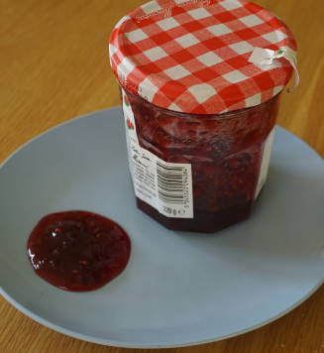
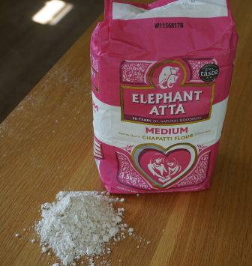
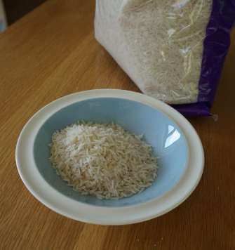
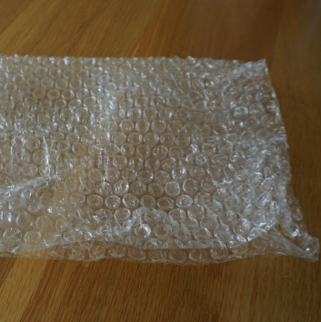
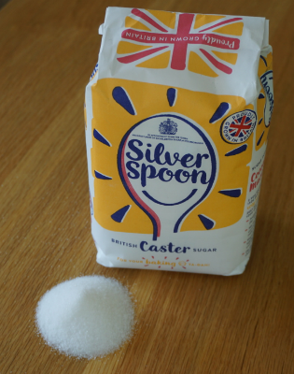
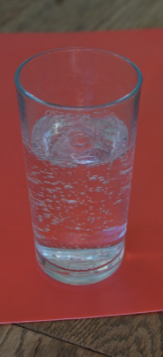
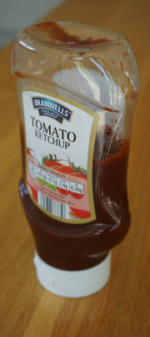
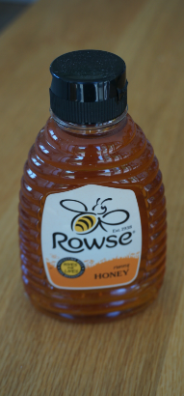
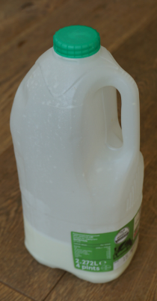
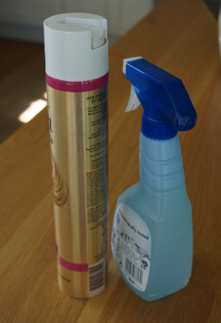
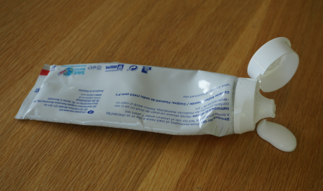
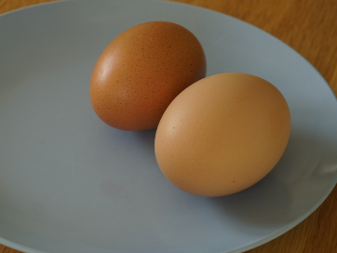
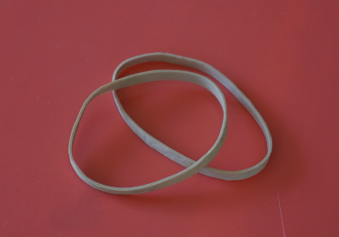
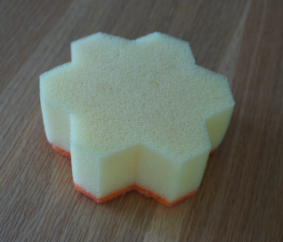
Look at the sheet attached.
Sort the items into solids, liquids and gases.
Some items may be ‘solid and liquid’, ‘liquid and gas’, ‘solid and gas’ – or ‘all three’!
Can you explain any of your decisions.
Items you may like to use:
fruit jam, flour, rice, bubble wrap, sugar, fizzy drink, ketchup, honey, milk, air freshener, toothpaste, uncooked egg, elastic band, sponge.

