Slide 1
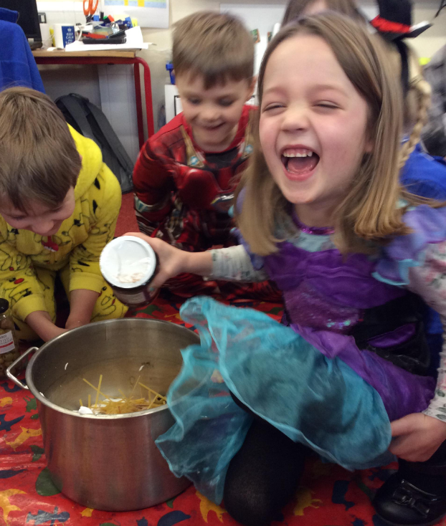
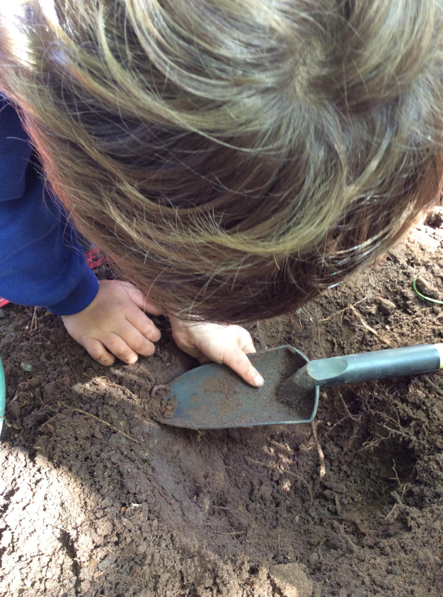
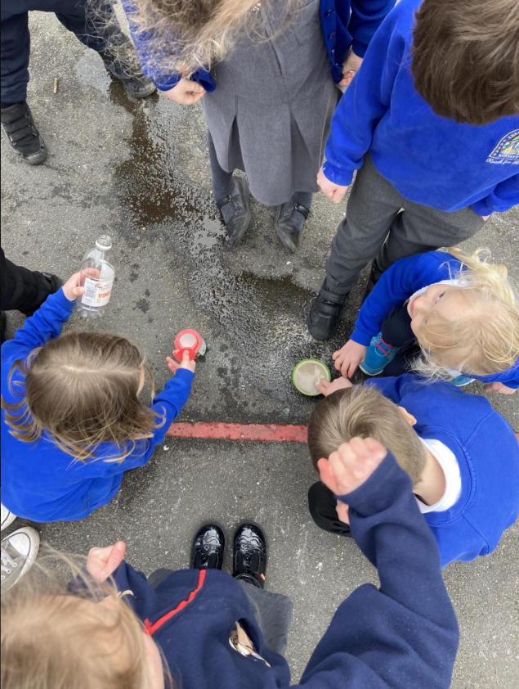
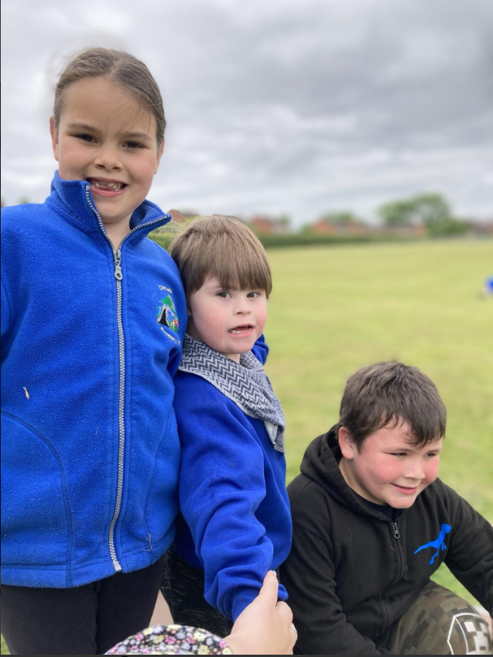
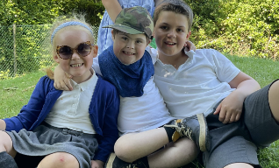
Welcome to Class 1
MONTH20XX
“Reach for the Stars”
New Parents’ Meeting

Slide 2
Meet the staff
On behalf of everyone here at Cheswardine Primary and Nursery School, WELCOME to a new and exciting stage in your child’s life.
Mrs Williams – Executive Head Teacher
Miss Gray – Class Teacher
Mrs Bullock – Class 1 teaching assistant
6 – Year 2 children
9 – Year 1 children
3 - Reception

Slide 3
Early Years Foundation Stage
The Foundation Stage begins in Nursery and continues through to Reception. We help the children to learn through playing, exploring and being active. This means children will take part in a range of fun, practical activities. We follow the EYFS Framework which explains how and what your child will be learning. It is very flexible so it can be adapted to the children’s needs and interests.

Slide 4
Just Playing By Anita Wadley
When I'm a building in the block room, Please don't say, "I'm just playing" For, you see, I'm learning as I play About balance and shapes. When I'm getting all dressed up, Setting the table, caring for the babies, Don't get the idea I'm "just playing." I may be a mother or a father someday. When you see me up to my elbows in paint, Or standing at an easel, or moulding and shaping clay, Please don't let me hear you say, "He's just playing" For you see, I'm learning as I play. I'm expressing myself and being creative. I may be an artist or an inventor someday.
When you see me sitting in a chair "Reading" to an imaginary audience, Please don't laugh and think I'm, "just playing" For, you see, I'm learning as I play. I may be a teacher someday.
When you see me combing the bushes for bugs, Or packing my pockets with choice things I find, Don't pass it off as "just playing." For, you see, I'm learning as I play. I may be a scientist someday. When you see me engrossed in a puzzle, Or "plaything" at my school, Please don't feel the time is wasted in "play" For, you see, I'm learning as I play. I'm learning to solve problems and concentrate. I may be in business someday. When you see me cooking or tasting foods, Please don't think that because I enjoy it, it is just "play" For, you see, I'm learning as I play. I'm learning how my body works. I may be a doctor, nurse, or athlete someday. When you ask me what I've done at school today, And I say "I played," Please don't misunderstand me. For, you see, I'm learning as I play. I'm learning to be successful in work. I'm preparing for tomorrow. Today, I'm a child and my work is play.

Slide 5
Early Years Curriculum
Your child will be learning skills, acquiring new knowledge and demonstrating their understanding through 7 areas of learning and development.
Children should mostly develop the 3 prime areas first. These are:
1. Communication and language
2. Physical development
3. Personal, social and emotional development.
As children grow, the prime areas will help them to develop skills in 4 specific areas. These are:
1. Literacy;
2. Mathematics;
3. Understanding the world; and
4. Expressive arts and design.

Slide 6
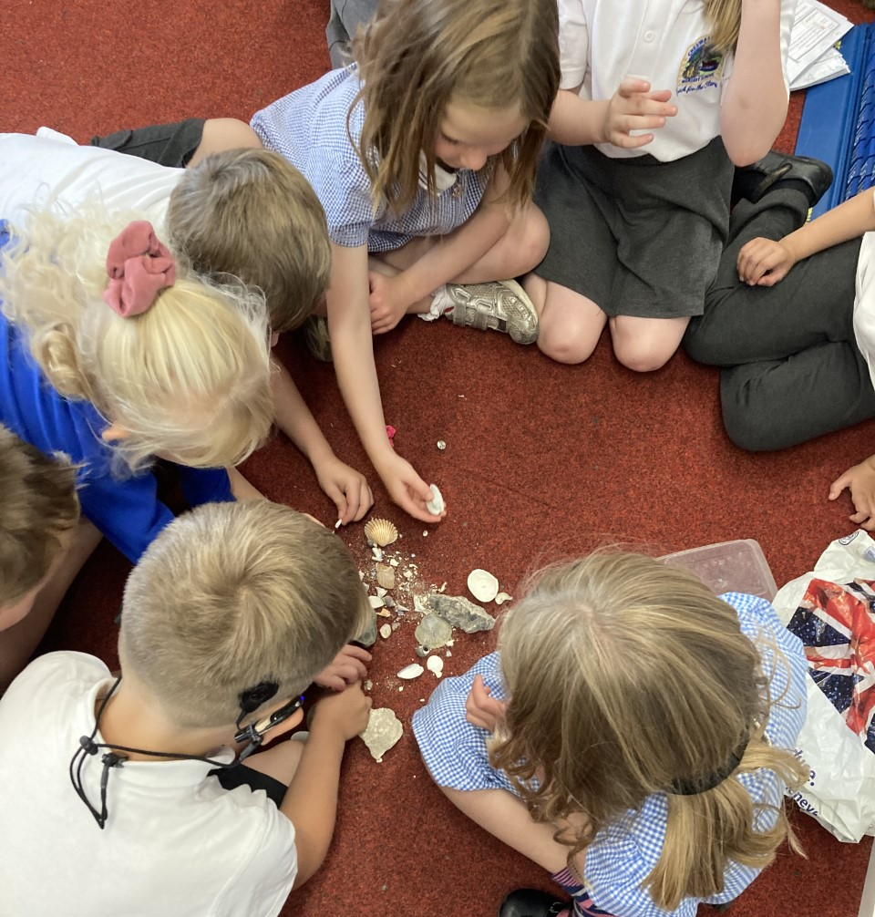
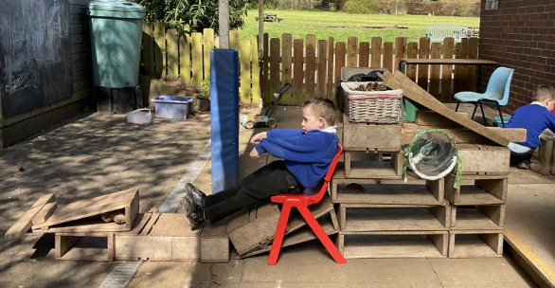
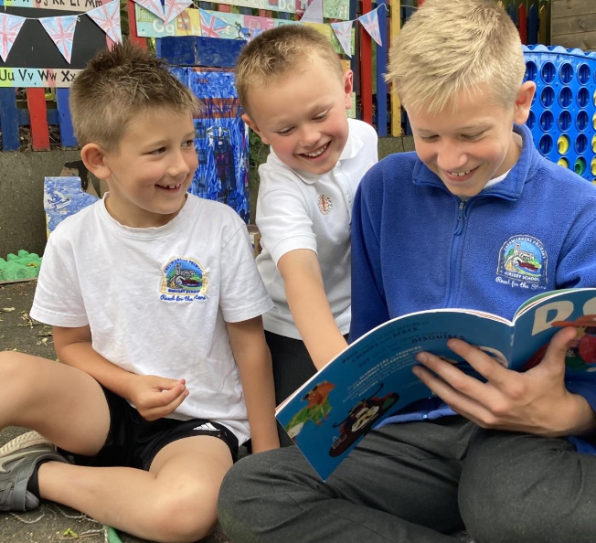
In the end ...
Independent learners
Problem solvers
Children who enjoy learning

Slide 7
By the end of the Reception year the goal is for your child to meet the ELG’s (Early Learning Goals):
Example- ELG: Writing
Children at the expected level of development will: - Write recognisable letters, most of which are correctly formed; - Spell words by identifying sounds in them and representing the sounds with a letter or letters; - Write simple phrases and sentences that can be read by others.
Example- ELG: Number
Children at the expected level of development will: - Have a deep understanding of number to 10, including the composition of each number; Subitise (recognise quantities without counting) up to 5; - Automatically recall (without reference to rhymes, counting or other aids) number bonds up to 5 (including subtraction facts) and some number bonds to 10, including double facts.

Slide 8
Example- ELG: Understanding the World: Past and Present
Children at the expected level of development will: - Talk about the lives of the people around them and their roles in society; - Know some similarities and differences between things in the past and now, drawing on their experiences and what has been read in class; - Understand the past through settings, characters and events encountered in books read in class and storytelling.
Example- ELG: Personal, Social and Emotional Development : Self-Regulation
Children at the expected level of development will: - Show an understanding of their own feelings and those of others, and begin to regulate their behaviour accordingly; - Set and work towards simple goals, being able to wait for what they want and control their immediate impulses when appropriate; - Give focused attention to what the teacher says, responding appropriately even when engaged in activity, and show an ability to follow instructions involving several ideas or actions.

Slide 9
In early July you will be told whether your child’s development is emerging or expected in relation to the early learning goals.
More details about the EYFS Profile are available from www.foundationyears.org.uk

Slide 10
Reception Baseline
The reception baseline assessment (RBA) is a short, task-based assessment of your child’s early literacy, communication, language and mathematics skills when they begin school. From September 2021, it has been a requirement for all schools. There is no pass mark or score and your child should not realise they’re doing an assessment.
What you need to do
You do not need to do anything. Your child is unlikely to even know that they are doing an assessment when they are completing the tasks.
The data from the assessment will only be used at school level to measure the progress of the year group from reception to year 6. The data from the assessment, including numerical scores, will not be shared with parents, pupils, teachers, or external bodies, including schools. There will be no published score.

Slide 11
Partnership
A good partnership between home and school is essential for children to make the most progress with their education.
Children only spend 20% of their time in school.
Parents play the biggest role in their child’s life long learning.
We value your partnership, working alongside us, to achieve the best start for your children.

Slide 12
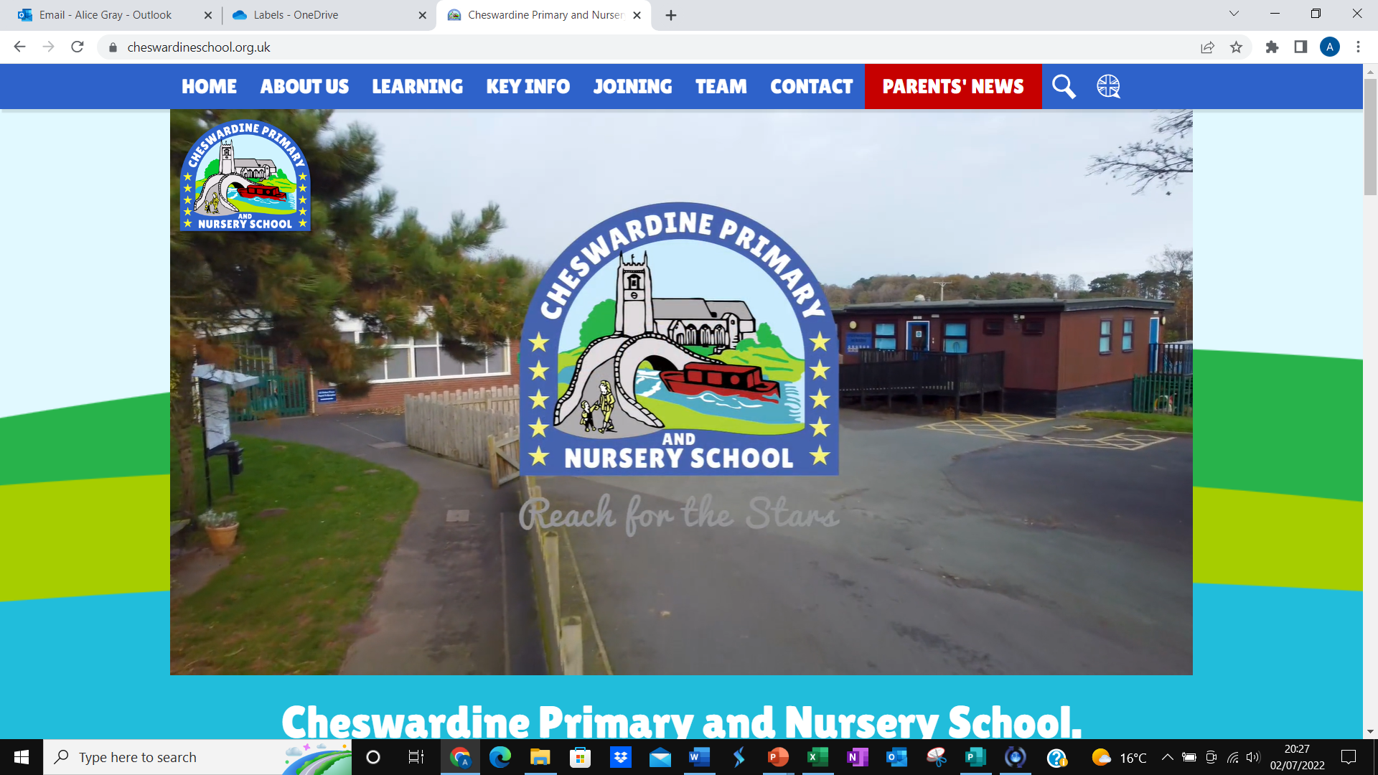
www.cheswardineschool.org.uk

Slide 13
How to check in on your child
It is important that staff and parents work together. We really value learning at home, and want you to be part of your child's learning and development. We want you to feel comfortable about exchanging information and discussing things that will benefit your child.
Class dojo (logins for this will be sent out in September) Look out for our ‘class story’ updates and you can also send over photos of work done / achievements. Share positive /negative dojos and message teachers.

Slide 14
Alternative communication
School website Photos, letters, information, policies etc
Share learning at home Bring in any work done at home- children love to share this
Email / contact me admin@cheswardine.shropshire.sch.uk
Or ring school and we will get back to you ASAP

Slide 15
The first few weeks
We will find out what the children already know and can do and use this information to help us develop exciting, purposeful learning experiences.
If you ever have any concerns or queries
please do not hesitate to speak to a member
of staff.
Autumn Term Focus
Settling in
Personal/social skills
School routines and expectations
Developing independence
Baseline Assessment

Slide 16
School Uniform
https://www.schooltrends.co.uk/uniform/CheswardinePrimarySchoolTF92RU
Please ensure that your child’s name is in all items of clothing, including shoes!
Blue jumper/cardigan
Grey or black trousers/skirt
Grey or black shorts or blue gingham style dress in Summer
Sensible black shoes (without laces unless your child can do them up independently)
Warm and waterproof coats (we take the children outside in all weathers throughout the year)
Book bag
Packed lunch box if required
Your child will be taking part in lots of interesting and sometimes messy experiences, so may come home dirty! It is all part of the fun!

Slide 17
PE Kit
https://www.schooltrends.co.uk/uniform/CheswardinePrimarySchoolTF92RU
P.E kit must be worn to school on PE days- we will let you know these in September. Please try to encourage children to get changed on their own as much as possible.
PE Kit must be school kit:
Logo white t-shirt
Blue shorts
Blue hooded jumper/fleece available
Socks
Trainers

Slide 18
Pupil Premium
If you are a low income family your child may be entitled to an extra pot of funding from the Government.
We use this money to provide extra support for your child if it is needed – this might take the form of extra phonic sessions, reading with an adult, maths basic skill groups etc.
Please check to see if your child qualifies by using the following website:
https://shropshire.gov.uk/free-school-meals/are-you-eligible-for-free-school-meals/
Please speak to Mrs Smith if you require any further information regarding Pupil Premium

Slide 19
Reading books
Children will start off with a sharing book. Once they begin to recognise sounds and are beginning to segment (Fred talk) and blend, they will be given a reading book to start reading with an adult.
Children will also move on to blending books and eventually phonics books which will come home for 1 night roughly every 3 days.
Please write in your child's reading record. Children are encouraged to read everyday, it only needs to be a couple of pages!

Slide 20
Routines
Morning Routines
Afternoon Routines
Please say goodbye to children at the gate.
Children will come in and hang up coats and lunch boxes.
Register will be taken for dinners and attendance
Activities on the carpet or table
Collect from the gate (3:15)
Please dojo or let a member of staff know if someone else will be picking up your child.

Slide 21
General Information
All children to start from Wednesday 6th September.
School day gate opens 8.40, registration closes at 8:45am
Finish at 3:15pm
Free school dinners for children in Reception to Year 2 and the menu is on the website
Packed lunches clearly labeled with name

Slide 22
Our Top Tips
Name EVERYTHING in permanent marker with your child’s name and class. Biro washes off very quickly. Coats, hats, gloves, PE bag, PE kits, plimsolls, JUMPERS, school shirts, trousers.
Check that your child’s winter coat has a zip that is easy to do up. Some zips are impossible for the child to do themselves! Practise putting on and doing up coats, it is really helpful as it develops children's sense of independence.
When choosing school shoes, ones with Velcro instead of shoelaces are helpful for younger children. Shoes need to be sensible, flat, black shoes – no sandals or open-toed shoes please.
Help your child feel comfortable and able to go to the toilet themselves. Encourage them to be independent and able to look after themselves.
n

Slide 23
Please remember...
Forms to complete –
Please fill these in and return to school ASAP
If you have any concerns or questions, we will be happy to help you.
admin@cheswardine.shropshire.sch.uk
FAO Miss Gray

Slide 24
Thank you for your time
We promise to look after your precious little people and make their first school year exciting and fun!

