Slide 1
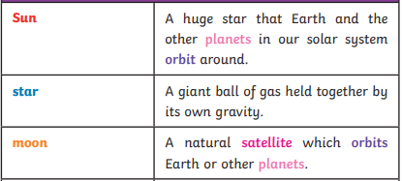
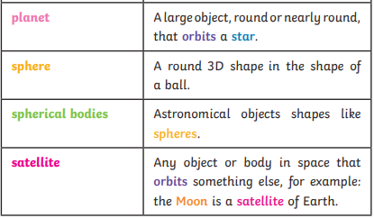
Earth and space
Recap
The sun is in the center of our solar system
The Earth orbits the sun and the moon orbits the earth.
The Sun allows plants to grow.
Crucial Knowledge
Earth rotates (spins) on its axis. It does a full rotation once in every 24 hours. At the same time that Earth is rotating, it is also orbiting (revolving) around the Sun. It takes a little more than 365 days to orbit the Sun.
The Moon orbits Earth - at various times in a month, the Moon appears to be different shapes. This is because as the Moon rotates round Earth, the Sun lights up different parts of it
Daytime occurs when the side of Earth is facing towards the Sun.
Night occurs when the side of Earth is facing away from the Sun
Extended knowledge
The work and ideas of many astronomers combined over many years before the heliocentric model was developed. Galileo's work on gravity allowed astronomers to understand how planets stayed in orbit.
Key Vocabulary

