Slide 1
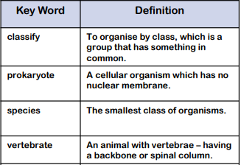
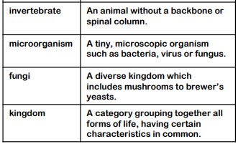
Classifying organisms
Recap
Know that living things can be grouped in a variety of ways
Use classification keys to help group, identify and name a variety of living things in their environment
Recognise that environmental changes can pose dangers to living things.
Crucial Knowledge
Describe how living things are classified into broad groups according to common observable characteristics and based on similarities and differences, including micro-organisms, plants and animals
Use and create classification keys
Give reasons for classifying plants and animals based on specific characteristics
Understand the significance of the work of the scientist Carl Linnaeus, a pioneer of classification
Extended knowledge
Use knowledge of scientific names to accurately create and name own creature.
Research unfamiliar animals and plants from a broad range of other habitats and decide where they belong in the classification system.
Key Vocabulary

