Slide 1
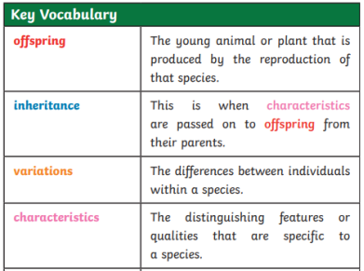
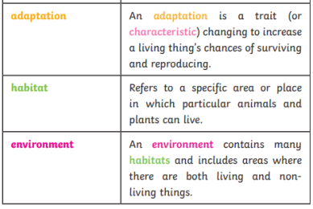
Evolution and inheritance
Recap
Identifying animals and plants using classification keys
Features of habitats and the animals and plants that exist there (biodiversity)
Sometimes environments can change and this has an effect on the plants and animals that exist there
Living things breed to produce offspring which grow into adults. This is called reproduction.
Crucial Knowledge
Recognise that living things have changed over time and that fossils provide information about living things that inhabited the Earth millions of years ago
Recognise that living things produce offspring of the same kind, but normally offspring vary and are not identical to their parents
Identify how animals and plants are adapted to suit their environment in different ways and that adaptation may lead to evolution
Extended knowledge
Increase understand of the work in which genes and chromosomes work
Raise questions about local animals and how they are adapted
Analyse advantages and disadvantages of specific adaptations
Key Vocabulary

